Slide 1

Information Operations
Steven M. Bellovin, Jason Healey, Matt Waxman
Fall 2017

Slide 2
Information Operations
Attack someone using information—bits
Sometimes, it’s propaganda
Other times, it’s hacking
During the 2016 election campaign, Russia did both of these and more

Slide 3
Hacking

Slide 4
The DNC
“Someone”—the US intelligence community says, with high confidence, that it was Russia—hacked a Democratic National Committee email server.
They also hacked John Podesta’s email.
These were strategically leaked by “Guccifer 2.0”
  Some “leaked” documents purporting to be from the Clinton Foundation were from elsewhere or were forgeries

Slide 5
Wikileaks
On October 7 at 4:00pm, the Washington Post broke the story about the Access Hollywood tape
Two hours later, Wikileaks published 2,000 of John Podesta’s stolen emails
Clinton: “And I've no doubt in my mind that there was some communication if not coordination to drop those the first time in response to the Hollywood Access tape.”
http://www.abc.net.au/news/2017-10-16/hillary-clinton-says-julian-assange-helped-donald-trump-win/9047944

Slide 6
Podesta’s Email
Podesta received an email like this
His sysadmin said it was legit
  Apparently, he meant to say “not legit”
The link goes to a bit.ly address
The attackers didn’t secure their bitly acount…

Slide 7
Looks Legit at First Glance

Slide 8
The Actual Hostname

Slide 9
Who Did It?
Both the IC and many private security firms attributed the attack to Russia
Two different hacking groups involved
  “Cozy Bear” (AKA APT29): the FSB and/or SVR
  “Fancy Bear” (APT28): the GRU

Slide 10
Election Systems
Elections are composed of many different pieces
  Voting machines
  Vote-counting computers
  Registration computers
  Electronic poll books
  Many more (e.g., online system to check registration status)

Slide 11
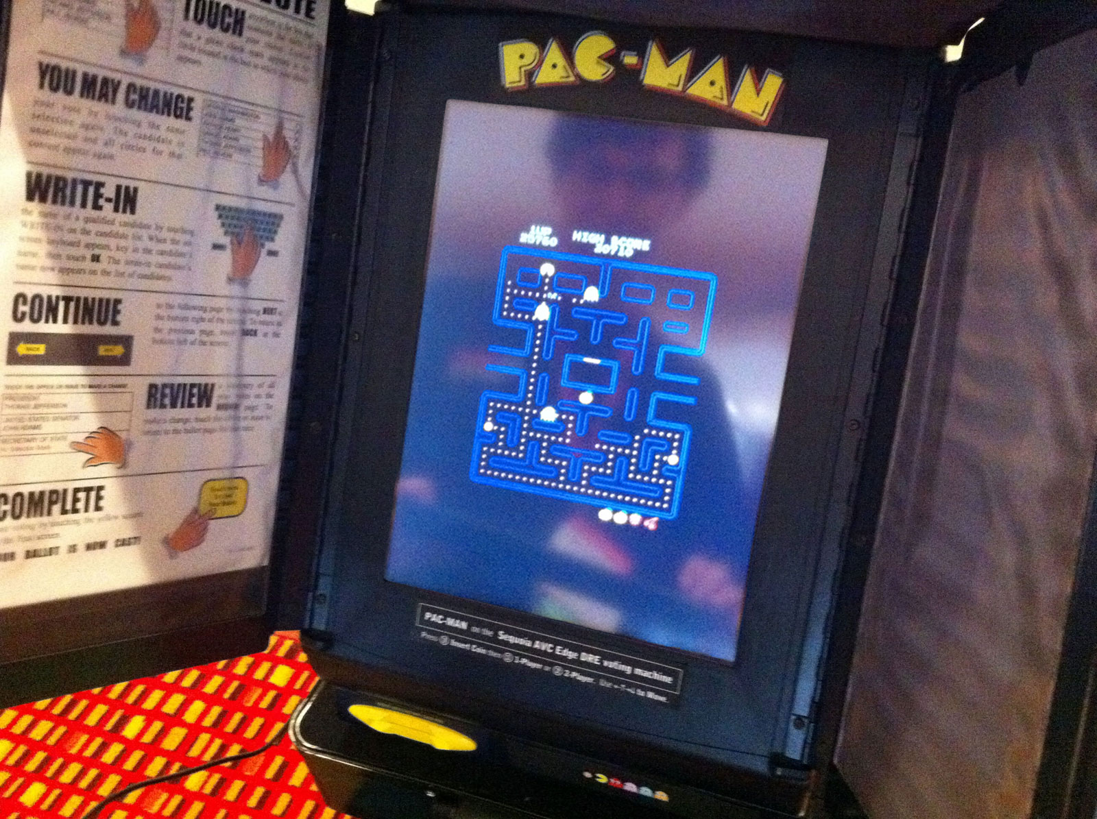
Voting Machines
Every independent audit has shown that computerized voting machines are very insecure
It’s possible for attackers to completely replace the software
Don’t forget lifecycle issues
Photo courtesy Alex Halderman

Slide 12
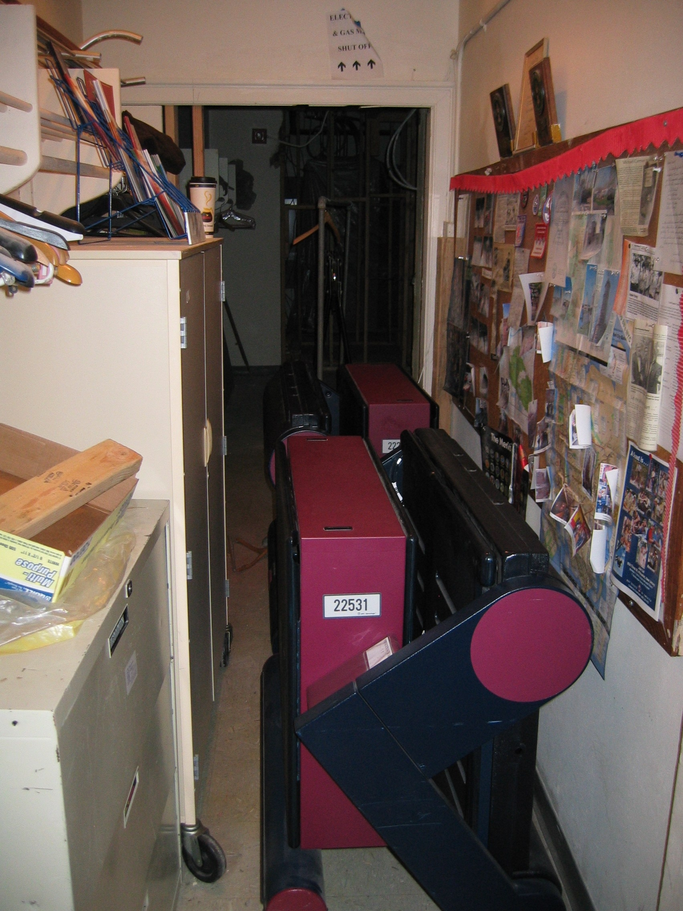
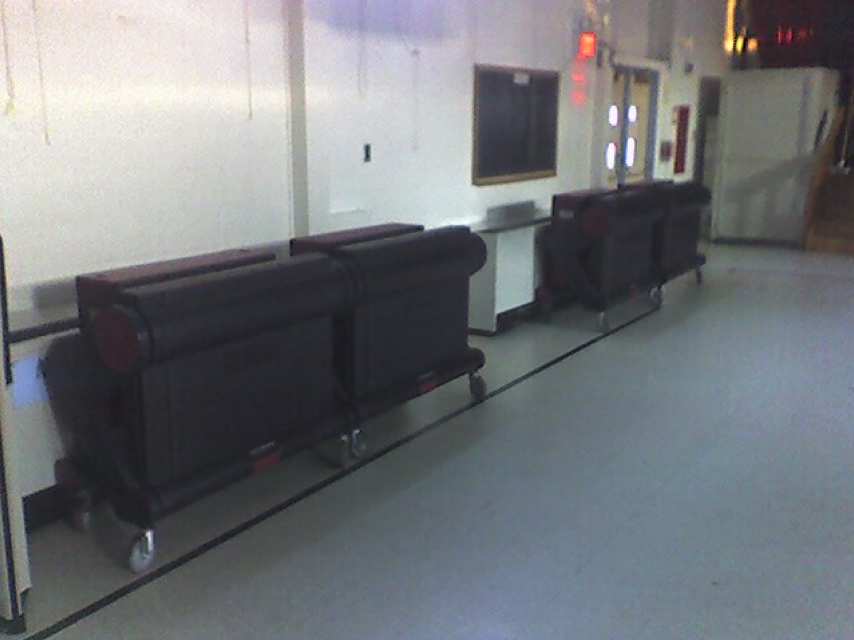
Voting Machine Storage
Before an Election
Photos courtesy Ed Felten

Slide 13
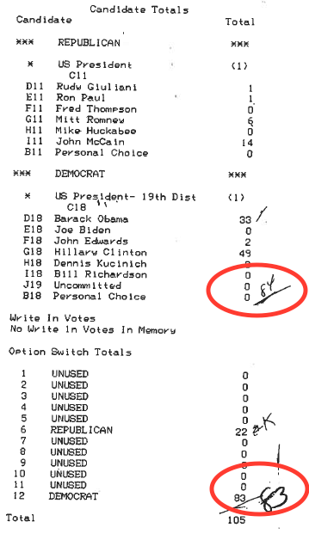
And There are Ordinary Bugs
The per-candidate totals show 84 Democratic votes and 22 Republican votes
The ballot selection totals show 83 Democratic votes and 22 Republican votes
Huh?
https://freedom-to-tinker.com/blog/felten/nj-election-discrepancies-worse-previously-thought-contradict-sequoias-explanation/

Slide 14
Paper Audit Trails
Most—but not all—states now use voting machines that provide paper audit trails
  Few voters check the paper ballot for accuracy
Some, like New York, use machine-scanned paper ballots
But there are few, if any, proper audits
  Rhode Island and Colorado will conduct “risk-limiting audits” in the future

Slide 15
Vote-Counting Software
Bernalillo County, NM: in-person voters used DRE machines; absentee ballots used optical mark cards
On Election Day in 2000, the absentee ballots appeared to go for Gore
That was odd—in that jurisdiction, absentee ballots tend to skew GOP
The problem: the counting program didn’t handle the “straight ticket” option properly
The elections supervisor: the software was buggy
The vendor: he programmed it incorrectly

Slide 16
Registration Databases
Registration databases—sometimes run by the state—are fairly complex pieces of software
They often have online connectivity
  Upload/download from counties
  Let voters check their status
If you’re not listed, you can’t vote…

Slide 17
Enter the Russians
Voting machines are hackable—but they’re not good targets
  There are more than 3,000 counties in the US; most run their own voting systems
  There are many different types of voting machines, and most (usually) aren’t on the Internet
But—what about the registration database? What about the poll books?

Slide 18
Enter the Russians
DHS says that Russia probed the election systems of many different states
  The exact number is in dispute
Were they adding voters? Deleting voters? Stealing information?
  Durham County, NC had electronic poll book problems—some suspect hacking, though this is hotly disputed

Slide 19
What Did Hacking Accomplish?
The release of the stolen emails seems to have had some effect, though the extent isn’t clear
  They certainly were a distraction
No credible evidence of actual attacks on voting machines
It remains unclear what the purpose or effect was of registration database probes

Slide 20
And What Do
We Do About It?

Slide 21
Propaganda 2.0

Slide 22
Social Media
The Russians clearly used social media in an attempt to meddle with the election
The stories are often vague and contradictory, and sometimes downright weird
This is a moving target; there’s more news every day
Did they really use Pokémon Go to fan racial unrest?
Did they really tell their operatives to watch “House of Cards” to understand American politics?
Take much of this with many grains of salt!

Slide 23
Tactics
Use of Facebook, Twitter, and Google
  Others?
Bots, to post things, drive up follower counts, repost
  The exact number is subject to dispute
Ads
Bloggers; fake news
Perhaps offering the Trump campaign damaging information about Clinton
“Kompromat” on Trump?

Slide 24
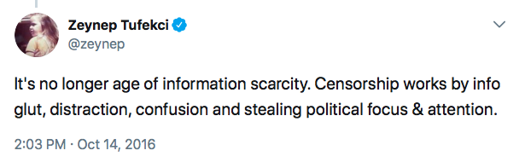
Distraction?
Create enough fake news and/or dubious news and/or targeted news to drown out the real stuff
Goal: leave people uncertain where to go for reliable information

Slide 25
Russian Goals
Defeat Clinton
  Some stories claim that Putin hates her for her actions while Secretary of State
Weaken the US
  Create or fan dissension
    Backed: Black Lives Matter; far right groups; Sanders; Stein
    Or so some stories claim
  Create doubts about the legitimacy of the election
Weaken US allies, especially NATO

Slide 26
Targeting
Stealing voter rolls from state election sites?
Cambridge Analytica? (per vox.com)
Internet Research Agency, in St. Petersburg?
Machine learning from Twitter feeds?
Geographical targeting, e.g., swing states

Slide 27
Are They Going Elsewhere?
Some reports allege links to the Brexit campaign
Fake news in France, just before the election
Germany?
Elsewhere?

Slide 28
And What Do
We Do About It?

