Slide 1
A Simple REAL TIME HARDWARE RAY TRACER
Dave Smith
Daniel Benamy
Keerti Joshi
Minjie Zhang

Slide 2
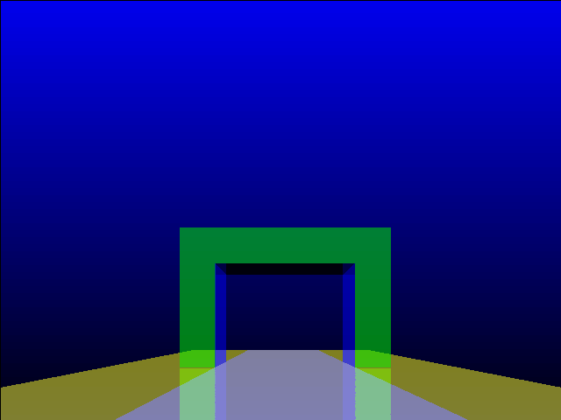
Ray tracing

Slide 3
Project Overview
Goals
  Rectangles
  Reflections
  60 frames a second

Slide 4
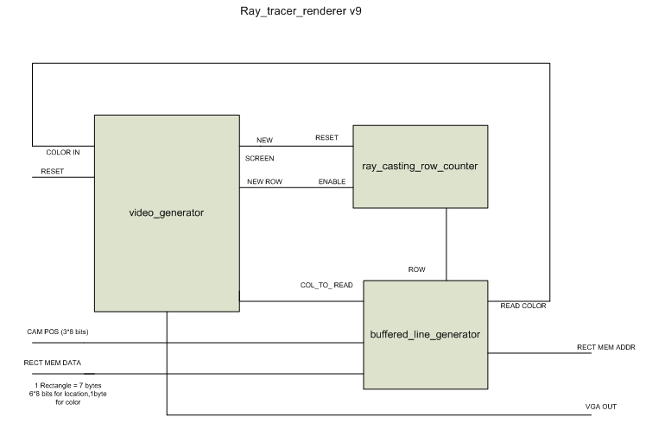
Architecture

Slide 5
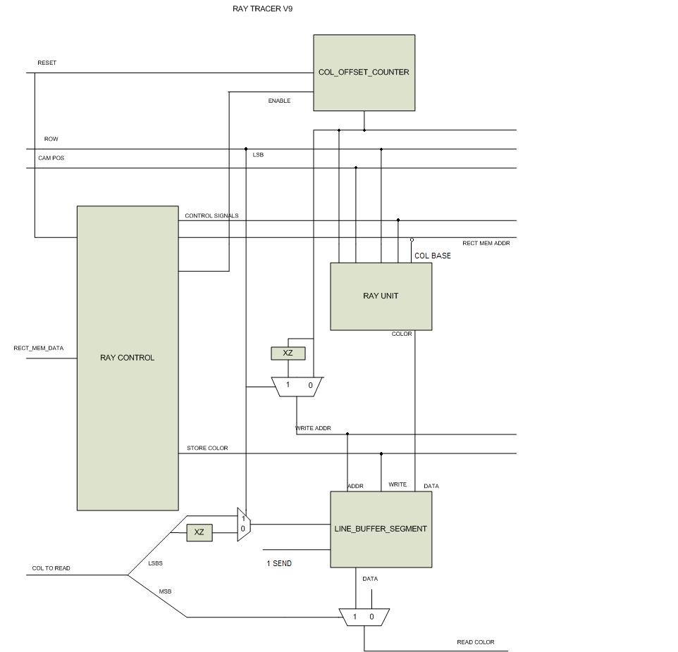
Architecture

Slide 6
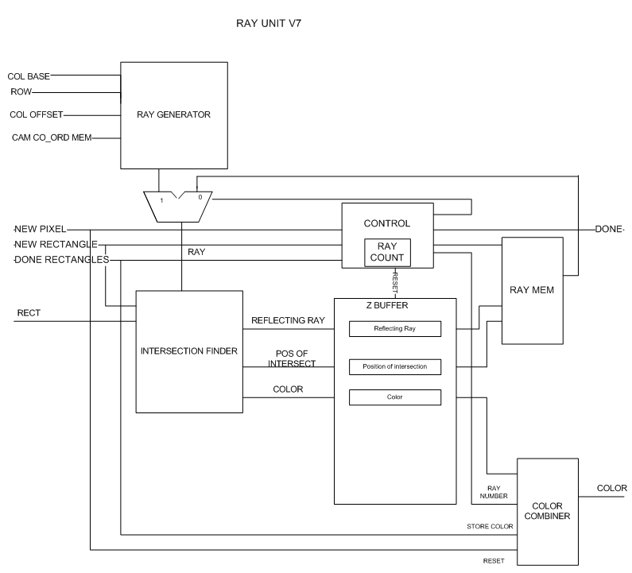
Architecture

Slide 7
Issues
1 Tool Problems
2 Divider
3 Compile Time
4 Difficult to fix graphical bugs
num
den
_
>>1
Result<<1
19 cycle Divider

Slide 8
Summary
A simple ray tracer
6 rectangles, 20 ray units
3 bit per cycle division
Simple games in software

Slide 9
Lessons learned
Start and finish early
Testing & debugging
Have the design or the prototype
  Block diagrams, C prototype ,timing analysis
Timing analysis
Notes:
Enough time for any enhancements or improvisation
Have extensive test cases & simulations working right

