Slide 1
Virtual Pool
Embedded Systems Design
Abdulhamid Ghandour, Thomas John
Jaime Peretzman, Bharadwaj Vellore
Columbia University

Slide 2
Concept and Objectives
Virtual Pool is a projection and vision-based pool game - uses a projected image of a pool table with balls placed on it
A camera placed some distance from the projected image and facing the image detects movements of a cue-like object and allows a player to strike balls
Initial Objective: Be able to strike a single ball with a cue-like object and have it bounce off the walls and possibly off other balls placed on the table

Slide 3
The System as it stands today
A two-player pool game with a scoring system and user selectable assists
Vector mathematics implemented for seven balls including a cue ball
All collisions accompanied by a clatter to enhance player experience
Intelligent calibration system involving minimal user effort

Slide 4
External Interfaces
SDAT
TRDB-DC2
Camera
Board
DE2 Altera Board (Cyclone II FPGA)
SYNC
VGA Display Device
SCLK
Pixel Data
Color
Signals
Analog Audio

Slide 5
Block Level View
Camera Controller
VGA Controller
UI Controller
NIOS II/f
Vision System
SRAM
Sound Driver

Slide 6
Flow Diagram - Calibration
Software
Pixel Interface
Image Cropper
Calibration
VGA Controller
Vision System

Slide 7
Flow Diagram – Game mode
Software
Pixel Interface
Image Cropper
Calibration
VGA Controller
Vision System

Slide 8
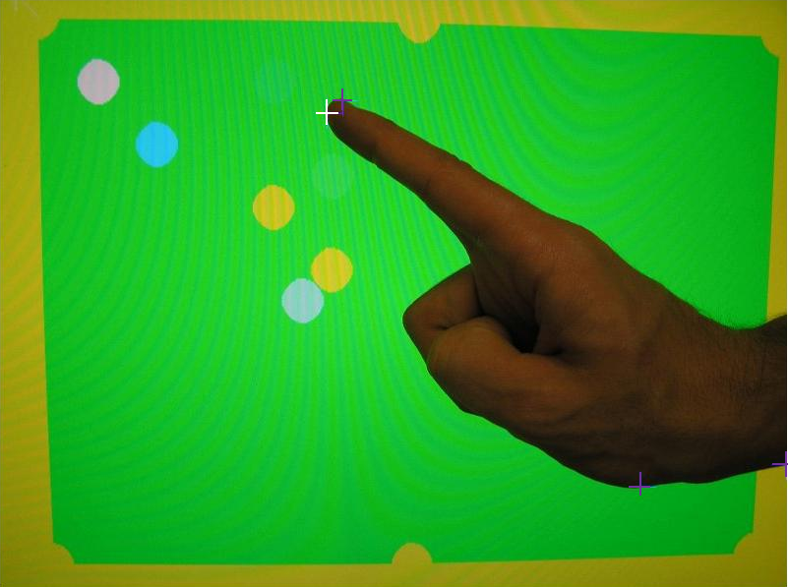
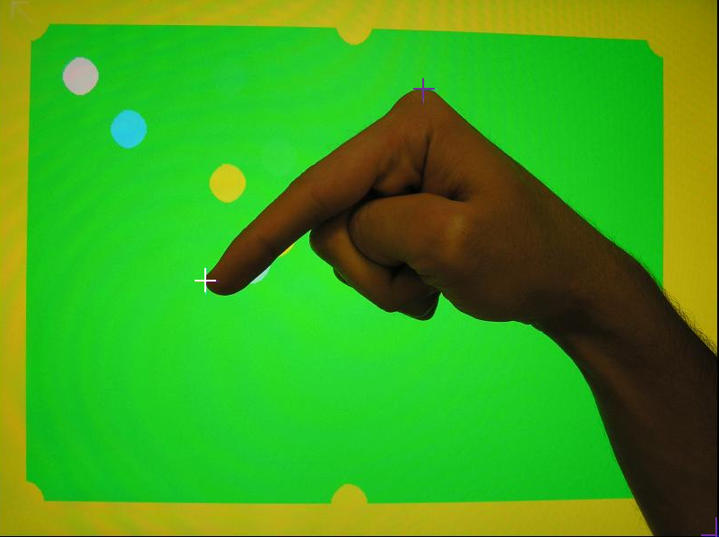
Vision System
The algorithm behind it all!
Uses information about the direction from which the object enters the view of the camera
To increase accuracy and robustness by selecting objects that are roughly the width of a finger

Slide 9
What we got right, and some lessons we learnt
Timing diagrams are critical; you can get it “first-time-right-by-design” with good timing analysis
Modularity in design permits working efficiently in parallel, and building system in increments
Exercise discretion is using source code obtained from a third party! Their I²C module never spoke to the camera; ours did
Carefully assess project risks and schedules : Camera – VGA controller was not worth the effort invested in it

Slide 10
Questions, and Time to Play Pool!
Acknowledgements:
Gtkpool, for part of the ball physics design
Sungjun Kim, for some valuable inputs on the audio system
WE INVITE YOU TO BEAT OUR TEAM CHAMPION – JAIME PERETZMAN – WE BUY YOU A SODA IF YOU WIN!

Slide 11
Project Management
Roles
  AG – VGA Controller, Calibration System
  TJ - Vision System, Ball Physics, User Interface
  JP – Calibration System, Sound System
  BV – Ball Physics, I2C/Pixel interface, User Interface
Tools
  Google Code, for version management
  Quartus/Nios-II, IDEs for VHDL and ‘C’ development and debugging

Slide 12
User Interface
System Calibrates automatically on start-up
  Instructs the user via the LCD screen, to move camera
    Left/Right, Forwards/Backwards, Up/Down
  Once calibrated, it waits for a few seconds to achieve stability before declaring the system ready for use
Key available for user to trigger recalibration (game will resume)
Key available for user to start new game

Slide 13
Game-play and Player Assists
Two-player game
  Players take alternate turns
Points system with the LCD screen indicating whose turn it is next
  Points are displayed on the seven-segment display
  Negative for pocketing the white!
Novice and Expert Modes
  Switch to turn ON/OFF cross-hair as guide

