Slide 1
Advanced Topics in Spoken Language Processing
Julia Hirschberg
CS 6998

Slide 2
Welcome to the Course!

Slide 3
My Background
First PhD in History at UMich on 16th-century first settlers in Puebla de los Angeles, Mexico
Taught at Smith College
Discovered CS from colleagues at Amherst and UMass
Back for another PhD at UPenn in CS (NLP)
Research on TTS at Bell Labs, and started the first HCI Research Dept which then moved to AT&T Labs
To Columbia in 2002, where I started the Columbia Speech Lab, have taught multiple Spoken Language Processing courses, and chaired the CS Dept (2012-18)
Research in many aspects of speech…
Notes:
Settlers’ demographics, relationships, locations, and activities
TTS in multiple languages, charismatic, emotional, trusted, deceptive speech, radicalization in online videos, fake information in twitter, hate tweets directed toward women journalists, cross-cultural communication, and empathetic speech

Slide 4
Intonation and discourse; TTS in multiple languages; charismatic, emotional, trusted and deceptive speech; entrainment; radicalization in online videos; false information in twitter and the intent behind it (malicious or benign), hate tweets directed toward women journalists; empathetic speech; dialogue systems; code-switching

Slide 5
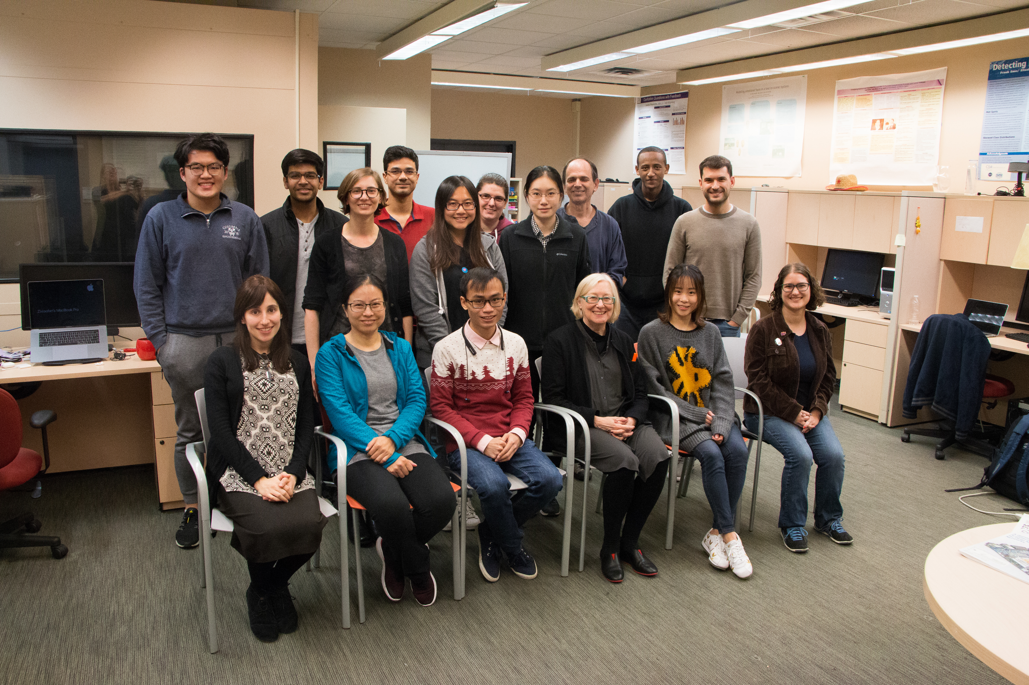
Columbia Speech Lab a While Back…

Slide 6
Getting to know each other
Notes:
5-6m
Remote: click on the participants symbol at the bottom of your screen; choose a name of someone you do not know and send them a brief introductory msg (e.g. your name, what college or school you are in, ugrad or ms?, how many years at Columbia? What your favorite color is). And respond back to anyone who messages you…
Earlier:
turn to the person sitting next to you and introduce yourself!
Compile a list of all the abbreviations you use in social media or email (e.g. LGTM)
Can we do this with emojis??

Slide 7
Course Focus: Speech Processing Questions
How do you produce sounds that other people interpret as language?
How does your hearer decode what you are trying to convey?
In a conversation, how do you know when it’s your turn to talk?
Once you decide what you want to say, how do you decide how to say it?:
How do you decide where to pause in the sentence?
How do you decide what words to emphasize?
How do you decide what intonational contour to use?
How do you convey your own feelings and emotions?
Notes:
Angry, sad, happy

Slide 8
Different languages can convey this information in different ways but most use intonation or sometimes word order in the process – and of course facial expression and body gesture also play a role in communication – which is why multimodal research has become so popular
How do you ask a question in your native language? Do you have a pet?
How do you make a statement? I have a cat.
Some links to information about prosody in multiple languages:
Mandarin Chinese:
Swedish
Hindi

Slide 9
French
Turkish
Italian
Singlish (Singapore English)
...If your own first language (or a language you know well) is one of these – or another language – please send me any useful links you find on prosody in that language so we can share with the class
What we’ll be learning in this class is a wide range of the information that speech can convey to others and what we in turn can learn about others from their speech

Slide 10
What Can We Convey and Learn from Speech
What speech can convey
What else we can learn from speech
Emotions: anger, fear, joy, sadness, disgust, surprise
Sarcasm, humor
Speech Acts
Empathy
Trust
Likability/Charisma
Persuasion
Intent
Deception
Mental health
Physical health
Autism and dysarthria
Entrainment
Charisma
Vocal Attractiveness
Age and gender
Personality
Notes:
Speech acts: question? Statement? Backchannels (um, uhuh…)
I know that.
I really believe you.

Slide 11
Basic Speech Technologies
Speech synthesis (TTS):
Many versions of concatenative, parametric, WaveNet, Deep Voice, Tacotron synthesis, FastSpeech, Flow-based, WageGlow, Deepmind TTS
Many challenges:
Do you live at 288 110th St. West?
The city hall parking lot was chock full of cars.
Martín Pérez plays for the Twins.
Speech recognition (ASR): and more
Free: Kaldi, Google Gboard and Speechnotes
Paid: Nuance Dragon, IBM Watson, Verbit, M$ Bing …
Many challenges: new languages, named entities, phone apps
Notes:
WaveNet, Deep Voice (Baidu), Tacotron (Google), FastSpeech (TTS with transformers), WaveGlow (Nvidia)
Spleeter for noise removal, aeneas for speech/transcript alignment,
TTS challenges…
Do you live at 288 110th St. West?
The city hall parking lot was chock full of cars.
Martín Pérez plays for the Twins.

Slide 12
Speech analysis:
Praat, Sox, WaveSurfer, Adobe Audition
Spleeter and Audacity for removing background noise
Aeneas for aligning text and speech
Please check the course’s Resources website for more…

Slide 13
Many Other Speech Applications
Speech to Speech Translation: Google Translate
Speech Search: Google Voice Search
For government:
Deception detection: false Information detection in news and social media and detecting lying for police, military, and social services
Dialect, language and speaker ID
Creating and detecting trust
Aids for first responders in low resource languages
Communication across cultures/languages
Sleepiness or drunkenness for drivers
For industry

Slide 14
Degree of interest e.g. for salespeople
Spoken Dialogue Systems: Siri, Alexa, Cortana, Google Home, Echo
Recognizing or generating emotion, e.g.
Recognizing anger/frustration in dialogue systems
Generating excitement/fear in games
Tutoring systems: Duolingo (uses Chrome to handle speech)
For society
Accessibility: Web access for visually or manually challenged, TTS’d audio books, MeowTalk
Voices for people who cannot speak clearly (Parrotron) or who have never been able to speak at all (Vocalid:Kids) or who are losing their voice (Vocalid: Elderly):
Recognizing confidence vs. uncertainty in tutoring systems

Slide 15
Medical diagnosis e.g. depression, aphasia, schizophrenia
Charisma for politicians, religious leaders, startup leaders – and conversational systems

Slide 16
What you will Learn in This Class
By the end of the course, you should be able to:
Understand more about these speech applications and how they work
Analyze acoustic and prosodic features of speech and connect these with text information (and sometimes visual features)
Analyze and classify corpora using these features to identify different types of information (dialogue acts, emotion)
Evaluate research papers on spoken language processing and produce useful questions about them

Slide 17
What You Should Know/Have before You Start
A laptop or access to a computer (hopefully a Mac but…)
Headphones with a close-talking mic for recording
Some knowledge of NLP or speech processing or linguistics
Some experience using Machine Learning (not necessarily Deep Learning) – scikit-learn.org, e.g.

Slide 18
Syllabus Overview
Course syllabus
Part 1: basic concepts, tools, analysis approaches
Acoustics, prosody, tools, TTS, ASR, dialogue systems
Part 2: speech analysis applications
Charisma, deception, dialogue acts, emotion, empathy, entrainment, humor, mental state, personality, mental state, radicalization, sentiment, sarcasm, trust

Slide 19
Grade breakdown
20% Weekly posts
20% HW 1
30% HW 2
30% HW 3

Slide 20
Weekly Readings
Textbook
Required: Speech and Language Processing, Jurafsky & Martin (use links from course syllabus)
Optional: Acoustic and Auditory Phonetics, Keith Johnson (3rd edition)
Conference papers and journal articles (all links in syllabus)

Slide 21
Weekly Posts
For weekly Reading Assignments: please provide 100-200 words (in several sentences) for each positive and each negative aspect of each assigned paper or chapter; this will give us a better chance to assess the quality of your responses.
For some Assignments you will also be asked to provide “an insightful and potentially challenging question about one of the readings.” Deadline: Mondays at 11:59 pm; Points 0-4
Late policy: 1 day,1 point loss

Slide 22
Sample Assignment from an earlier course for Jurafsky & Martin on Dialogue
Positive aspects:
I found this chapter interesting and enjoyed learning about the various approaches of building dialogues systems: rule based, corpus-based, sequence to sequence Chatbot and more. One of the things I appreciated the author including were ethical issues concerned with building dialog systems. They were very important issues raised such as the tendency for agents to have female names, biases in the training data and even more fascinating how users can corrupt an agents’ knowledge as in the case of Microsoft Tau making reinforcement learning a double edge-sword. In other words, while reinforcement learning can help chat-bots better personalize to a user it can also be trained to reflect discriminative opinions of the user.

Slide 23
Negative aspects:
One of the things that I felt was incomplete was in understanding turn-taking. How can the system know when the user is done speaking? On the note of prosody, in most conversation the emotional state and intent of a speaker can inform the type of response that is desired. How can a system deal with a situation when a user is sarcastic or frustrated in a conversation?
Challenge Question: Are there prosodic cues such as F0 contour that can help the system avoid overlapping speech with the user, which might cause the agent to miss out on important information?
Please do present your assignments in this form for each reading assigned.

Slide 24
Homework Assignments
Praat emotion recording and analysis
Dialogue Act identification and how these differ from one another
Emotional Speech identification (e.g. anger, sadness)
Late policy: 3 days only available after the deadline; 5 points lost for each day

Slide 25
Teaching Assistants
Introducing our TAs for the course this semester, my PhD students and their office hours:
Debasmita Bhattacharya: W 3-5pm
Yu-Wen Chen: F 2-4pm
Ziwei (Sara) Gong: Tu 1-3pm
Office hours’ zoom links are on Courseworks2 → Home
Notes:
Can you introduce yourselves and what research you do?

Slide 26
Todo
Please read the Ethics policy on our syllabus

Slide 27
Next Class
For our Week 2 class: Look at today’s slides and follow the links again (or any not followed today)
Week 2 Topic: From Sounds to Language
Reading: J&M Chapter 28 (sections 1-3)
Post your Week 2 assignment on Courseworks2 before next Monday at 11:59pm
Record your name on Courseworks2 → Name and Pronoun Recording so we can learn to pronounce everyone’s name correctly ☺
Make sure your picture is also on Courseworks2

Slide 28
Questions?

