Slide 1
Tools for Speech Analysis
Julia Hirschberg
CS4995/6998
Thanks to Jean-Philippe Goldman, Fadi Biadsy

Slide 2
A Speech Analysis Tool: Praat
Developed by Paul Boersma and David Weenink at the Institute of Phonetic Sciences, University of Amsterdam
General purpose speech tool : editing, segmentation and labeling, prosodic manipulation, many tutorials, large user community, yahoo group
Notes:
first aim of Praat was to give students and scientists of Phonetics a handy tool for manipulating speech data and for creating stimuli for perception experiments,

Slide 3
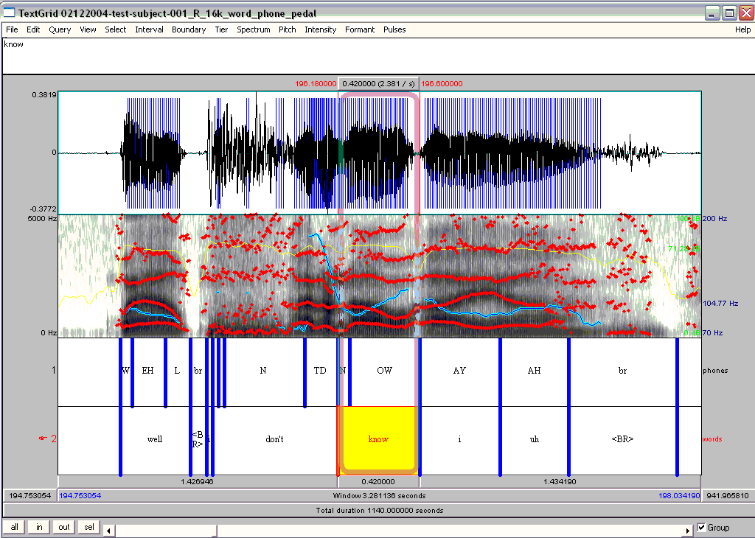

Slide 4
File Management
Recording files and saving them
New menu
Opening files
Read menu
Long and short sound files
Other file types
Write menu
Exercise: Record a file saying “My mama lives in Memphis” mono, play it to check, call it ‘<your name>’, save it to list, write it to a .wav file on disk, remove it from the objects list, read it back in

Slide 5
Display Options from Objects Window
Select and view&edit your ‘mama’ file
Spectrum:
Show a spectral slice
Show a spectrogram
Pitch:
Show pitch
Check the settings, change the range
Get pitch information: get pitch, get min/max pitch
Intensity:
Get intensity information: similar to pitch functions
Check the settings
Formant: Display

Slide 6
Modifying Data
Changing the pitch contour of your ‘mama’ file:
Go to To manipulation
Edit the new object
Pitch → Stylize pitch (2st)
Modify pitch by dragging points up and down
Modify duration:
Add points in duration tier
Drag points up and down to change rate
To save: File -> Publish resynthesis

Slide 7
Annotation: Textgrids
From objects window, w/ sound file selected
Annotate → To textgrid
Point vs. interval tiers
Add a point tier and an interval tier and insert some labels
NB: remember to select the interval or point first in the waveform or spectrogram before trying to insert a label

Slide 8
Scripting
From history:
Praat → new Praatscript → Edit → Paste history
NB: you can run all or part of the script
Writing scripts
Modifying existing scripts:
Tutorials, scripts, resources, user groups, search

Slide 9
Sample Praat Script
# This script will create a new text-grid for a wav file
form Make a text-grid for a .wav file
comment Source Directory?
sentence Directory C:\Documents and Settings\julila\My Documents\
comment File name?
sentence Filename
comment Tier Name?
sentence Tier
endform
Read from file... 'directory$‘ ‘filename$'
stem$ = left$(filename$,length(filename$)-4)
select Sound 'stem$'
To TextGrid... 'tier$' 'tier$‘ # tier names, which tiers are point tiers
Write to text file... 'directory$'\'stem$'.TextGrid
Remove

Slide 10
Task 1
Read in your ‘mama’ file and view&edit
Zoom in on the most prominent word and find a single cycle in wave form – select – what is the frequency?
Select the entire contour
Display the pitch and intensity contours
What is the minimum pitch? Maximum? Mean?
What is the minimum intensity? Maximum? Mean?

Slide 11
Task 2: Contours
Record a statement
Record a yes-no question
Record a wh-question
What are the similarities in F0? Differences?

Slide 12
Task 3: Clipping
Record something in a very loud voice, to produce clipping, and see what the waveform looks like – how do you identify clipping? Avoid it?

Slide 13
Task 4: Changing the Pitch Range
Record a file using falling intonation
Modify it to produce a rising intonational contour
Edit the new contour to
Raise the pitch range (select the contour and use ‘shift pitch frequencies’
Stylize the pitch contour

Slide 14
Task 5: Pitch contour cloning
Replace the pitch contour in beach.wav with the contour in speech.wav
Read in both files
Create a manipulation object for beach.wav
Extract the pitch tier
Create a manipulation object for speech.wav
Select the pitch tier of beach.wav and the manipulation object for speech.wav and click ‘Replace pitch tier’
Select the manipulation object for speech.wav and click ‘Get resynthesis…’
Compare the original file and the new file

Slide 15
Task 6: Emotional Speech
Record “My mama lives in Memphis” again
As angry speech
As sad speech
As happy speech
For each token answer the following:
What is the mean pitch? Maximum?
What is the mean intensity? Maximum?
What is the duration?
Do you see any differences in the F0 contour?

Slide 16
Task 7: Masking
Edit a mama file
Convert → Change Gender
Filter →filter (pass) Hann band
Find a pass band that masks the words but retains the intonation
Find a pass band that masks the intonation but retains the words
Modify → Reverse

Slide 17
Help
Online help, FAQ, manual
Links from http://www.praat.org
Additional tutorials, scripts, resources, user groups

Slide 18
Next Class
Prepare 5m presentations (max) for each team to present the idea for your project
Visit to Speech Lab in Cepsr

