Slide 1
Back-End Synthesis
Julia Hirschberg
CS 4706
(*Thanks to Dan and Jim)

Slide 2
Architectures of Modern Synthesis
Articulatory Synthesis:
  Model movements of articulators and acoustics of vocal tract
Formant Synthesis:
  Start with acoustics, create rules/filters to create each formant
Concatenative Synthesis:
  Use databases of stored speech to assemble new utterances.
HMM Synthesis
3/3/12
Text from Richard Sproat slides
2
Speech and Language Processing Jurafsky and Martin
Notes:
2

Slide 3

Formant Synthesis
3/3/12
Speech and Language Processing Jurafsky and Martin
3
Most common commercial systems (while computers relatively underpowered)
1979 MIT MITalk (Allen, Hunnicut, Klatt)
1983 DECtalk system
Voice of Stephen Hawking
Notes:
3

Slide 4

Concatenative Synthesis
3/3/12
Speech and Language Processing Jurafsky and Martin
4
All current commercial systems.
Diphone Synthesis
  Units are diphones; middle of one phone to middle of next.
  Why? Middle of phone is steady state.
  Record 1 speaker saying each diphone
Unit Selection Synthesis
  Larger units
  Record 10 hours or more, so have multiple copies of each unit
  Use search to find best sequence of units
Notes:
4
accuvoice

Slide 5
TTS Demos (all Unit-Selection)
3/3/12
5
Festival
  http://www-2.cs.cmu.edu/~awb/festival_demos/index.html
Cepstral
  http://www.cepstral.com/cgi-bin/demos/general
AT&T
  http://www2.research.att.com/~ttsweb/tts/demo.php
Notes:
5

Slide 6
How do we get from Text to Speech?
3/3/12
6
TTS Backend takes segments+f0+duration and creates a waveform
A full system needs to go all the way from random text to sound
Notes:
6

Slide 7
Front End and Back End
3/3/12
Speech and Language Processing Jurafsky and Martin
7
PG&E will file schedules on April 20.
TEXT ANALYSIS: Text to intermediate representation:
WAVEFORM SYNTHESIS: From intermediate representation to waveform
Notes:
7

Slide 8
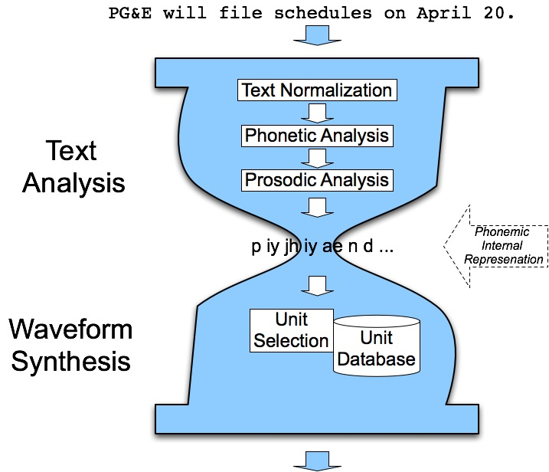
The Hourglass
3/3/12
Speech and Language Processing Jurafsky and Martin
8
Notes:
8

Slide 9
Waveform Synthesis
3/3/12
Speech and Language Processing Jurafsky and Martin
9
Given:
  String of phones
  Prosody
    Desired F0 for entire utterance
    Duration for each phone
    Stress value for each phone, possibly accent value
Generate:
  Waveforms
Notes:
9

Slide 10
Diphone TTS Architecture
Training:
  Choose units (kinds of diphones)
  Record 1 speaker saying at least 1 example of each
  Mark boundaries and segment to create diphone database
Synthesizing from diphones
  Select relevant set of diphones from database
  Concatenate them in order, doing minor signal processing at boundaries
  Use signal processing techniques to change prosody (F0, energy, duration) of sequence
3/3/12
Speech and Language Processing Jurafsky and Martin
10
Notes:
10

Slide 11
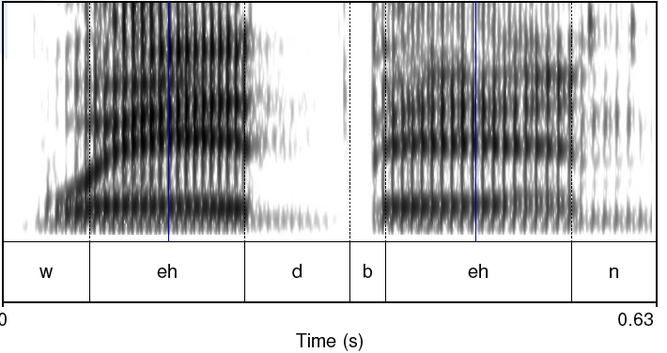
Diphones
3/3/12
Speech and Language Processing Jurafsky and Martin
11
Where is the stable region?
Notes:
11

Slide 12
Diphone Database
Middle of phone more stable than edges
Need O(phone2) number of units
  Some phone-phone sequences don’t exist
  ATT (Olive et al.’98) system had 43 phones
    1849 possible diphones but only 1172 actual
    Phonotactics:
      [h] only occurs before vowels
      Don’t need diphones across silence
  But…may want to include stress or accent differences, consonant clusters, etc
Requires much knowledge of phonetics in design
Database relatively small (by today’s standards)
  Around 8 megabytes for English (16 KHz 16 bit)
3/3/12
12
Notes:
12

Slide 13
Voice
3/3/12
Speech and Language Processing Jurafsky and Martin
13
Speaker
  Called voice talent
  How to choose?
Diphone database
  Called a voice
  Modern TTS systems have multiple voices
Notes:
13

Slide 14
Prosodic Modification
3/3/12
Text from Alan Black
14
Speech and Language Processing Jurafsky and Martin
Modifying pitch and duration independently
Changing sample rate modifies both:
  Chipmunk speech
Duration: duplicate/remove parts of the signal
Pitch: re-sample to change pitch
Notes:
14

Slide 15
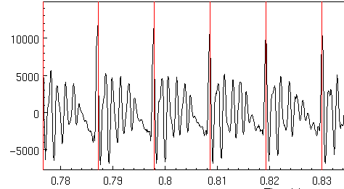
Speech as Sequence of Short Term Signals
3/3/12
Alan Black
15
Speech and Language Processing Jurafsky and Martin
Notes:
15

Slide 16
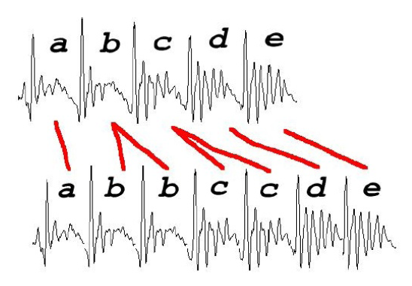
Duration Modification
3/3/12
Slide from Richard Sproat
16
Duplicate/remove short term signals
Notes:
16

Slide 17
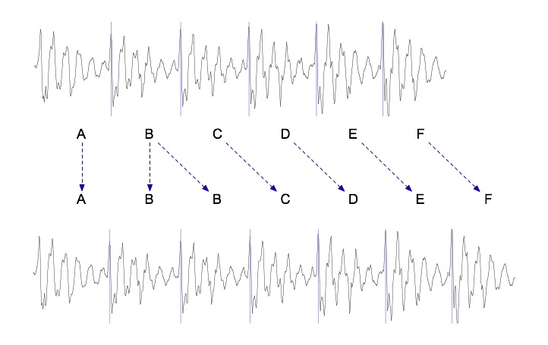
Duration modification
3/3/12
Speech and Language Processing Jurafsky and Martin
17
Duplicate/remove short term signals
Notes:
17

Slide 18
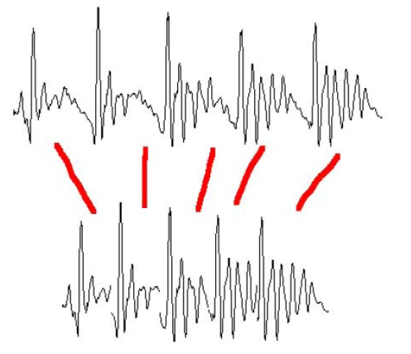
Pitch Modification
Move short-term signals closer together/further apart: more cycles per sec means higher pitch and vice versa
Add frames as needed to maintain desired duration
3/3/12
Slide from Richard Sproat
18
Speech and Language Processing Jurafsky and Martin
Notes:
18

Slide 19
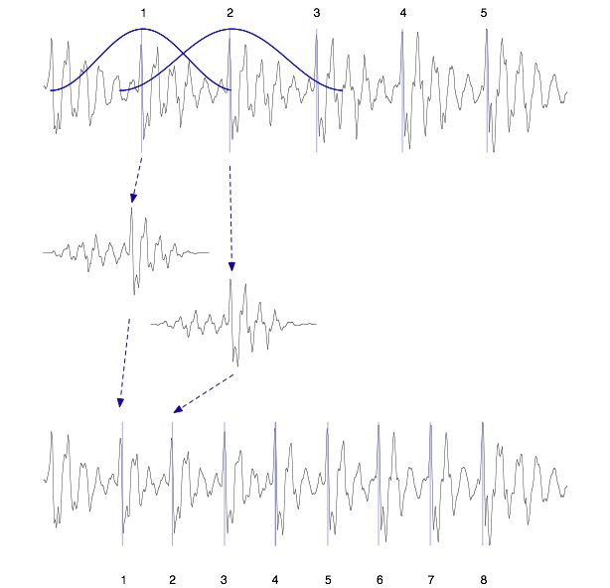
TD-PSOLA ™
Time-Domain Pitch Synchronous Overlap and Add
Patented by France Telecom (CNET)
Epoch detection and windowing
Pitch-synchronous
Overlap-and-add
Very efficient
Can modify Hz up to two times or by half
Smoother transitions
3/3/12
Speech and Language Processing Jurafsky and Martin
19
Notes:
19

Slide 20
Unit Selection Synthesis
3/3/12
20
Generalization of the diphone intuition
  Larger units
    From diphones to phrases to …. sentences
  Record many copies of each unit
    E.g., 10 hours of speech instead of 1500 diphones (a few minutes of speech)
  Label diphones and their midpoints
Notes:
20

Slide 21
Unit Selection Intuition
Given a large labeled database, find the unit that best matches the desired synthesis specification
What does “best” mean?
  Target cost: Find closest match in terms of
    Phonetic context
    F0, stress, phrase position
  Join cost: Find best join with neighboring units
    Matching formants + other spectral characteristics
    Matching energy
    Matching F0
3/3/12
Speech and Language Processing Jurafsky and Martin
21
Notes:
21

Slide 22
Targets and Target Costs
Target cost C(t,u): How well does target specification t match db unit u?
Goal: find unit least unlike target
Examples of labeled diphone midpoints
  /ih-t/ +stress, phrase internal, high F0, content word
  /n-t/ -stress, phrase final, high F0, function word
  /dh-ax/ -stress, phrase initial, low F0, word=the
Costs of different features have different weights
3/3/12
22
Notes:
22

Slide 23
Target Costs
3/3/12
23
Comprised of p weighted subcosts
  Stress
  Phrase position
  F0
  Phone duration
  Lexical identity
Target cost for a unit:
Notes:
23

Slide 24
Join (Concatenation) Cost
Measure of smoothness of join between two database units u_{i} and u_{j} (target irrelevant)
Features, costs, and weights
Comprised of p weighted subcosts:
  Spectral features
  F0
  Energy
Join cost:
3/3/12
24
Notes:
24

Slide 25
Total Costs
Hunt and Black 1996
We now have weights (per phone type) for features set between target and database units
Find best path of units through database that minimize:
Standard problem solvable with Viterbi search with beam width constraint for pruning
3/3/12
Slide from Paul Taylor
Speech and Language Processing Jurafsky and Martin
25
Notes:
25

Slide 26
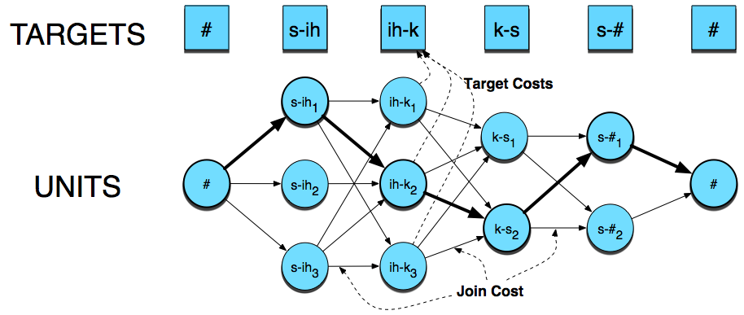
Synthesizing….
3/3/12
Speech and Language Processing Jurafsky and Martin
26
Notes:
26

Slide 27
Unit Selection Summary
Advantages
  Quality far superior to diphones: fewer joins, more choices of units
  Natural prosody selection sounds better
Disadvantages:
  Quality very bad when no good match in database
    HCI issue: mix of very good and very bad quite annoying
  Synthesis is computationally expensive
  Hard to control prosody
    Diphone technique can vary emphasis
    Unit selection can give result that conveys wrong meaning
3/3/12
27
Notes:
27

Slide 28
New Trend: HMM Synthesis
Hidden Markov Model Synthesis
Won recent TTS bakeoff
  Sounds less natural to researchers but naïve subjects preferred
  Has potential to improve over both diphone and unit selection
  Generate speech parameters from statistics trained on data
  Voice quality can easily be changed by transforming HMM parameters
3/3/12
Speech and Language Processing Jurafsky and Martin
28
Notes:
28

Slide 29
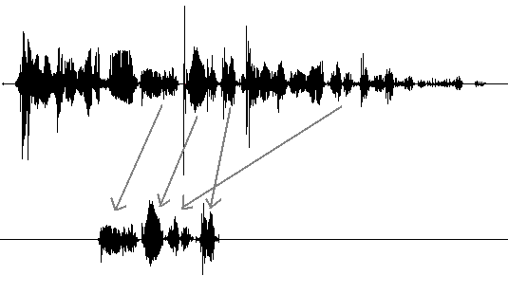
From Concatenation to Generation

Slide 30
HMM Synthesis
A parametric model
Can train on mixed data from many speakers
Model takes up a very small amount of space
Speaker adaptation

Slide 31
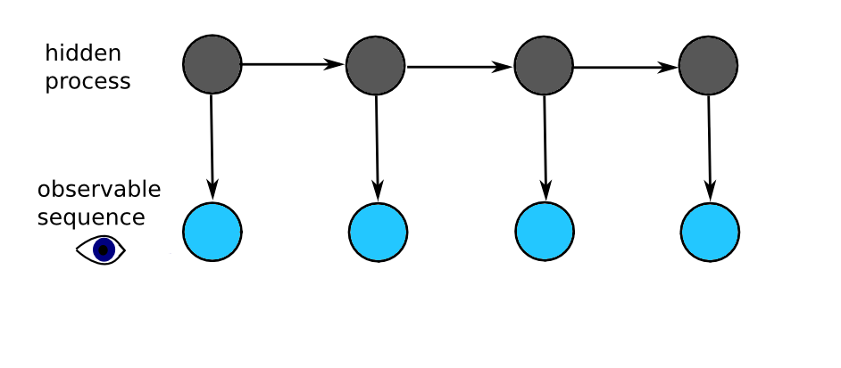
HMMs
Some hidden process has generated some visible observation.

Slide 32
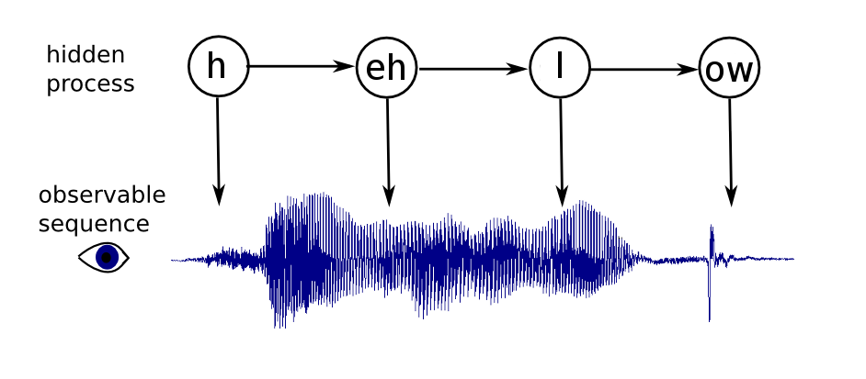
HMMs
Some hidden process has generated some visible observation.

Slide 33
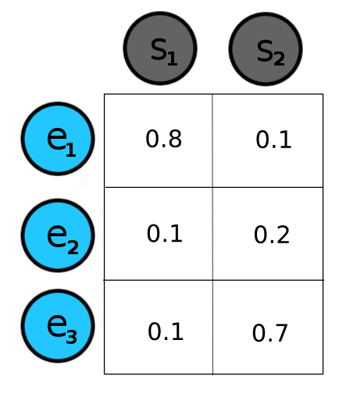
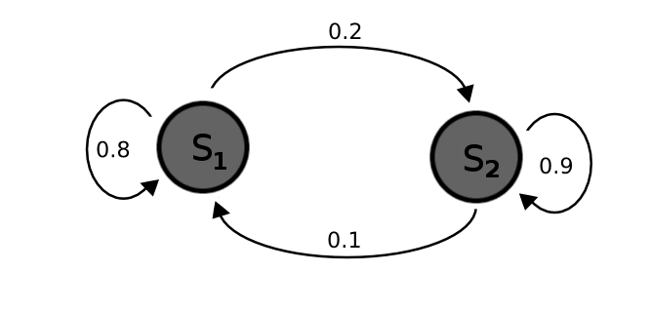
HMMs
Hidden states have transition probabilities and emission probabilities.

Slide 34
HMM Synthesis
Every phoneme+context is represented by an HMM.
The cat is on the mat.
The cat is near the door.
< phone=/th/, next_phone=/ax/, word='the',
next_word='cat', num_syllables=6, .... >
Acoustic features extracted: f0, spectrum, duration
Train HMM with these examples.

Slide 35
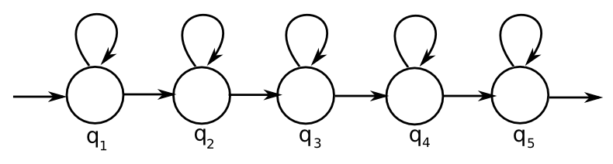
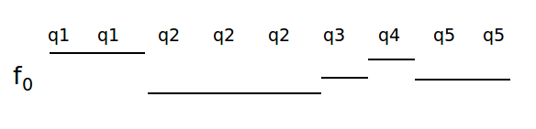
HMM Synthesis
Each state outputs acoustic features (a spectrum, an f₀, and duration)

Slide 36
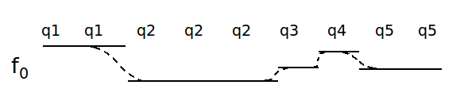
HMM Synthesis
Each state outputs acoustic features (a spectrum, an f₀, and duration)

Slide 37
HMM Synthesis
Many contextual features = data sparsity
Cluster similar-sounding phones
e.g: 'bog' and 'dog'
the /aa/ in both have similar acoustic features, even though their context is a bit different
Make one HMM that produces both, and was trained on examples of both.

Slide 38

Experiments: Google, Summer 2010
Can we train on lots of mixed data? (~1 utterance per speaker)
More data vs. better data
15k utterances from Google Voice Search as training data
ace hardware rural supply

Slide 39
More Data vs. Better Data
Voice Search utterances filtered by speech recognition confidence scores
50%, 6849 utterances
75%, 4887 utterances
90%, 3100 utterances
95%, 2010 utterances
99%, 200 utterances

Slide 40
Future Work
Speaker adaptation
Phonetically-balanced training data
Listening experiments
Parallelization
Other sources of data
Voices for more languages

Slide 41
Reference
http://hts.sp.nitech.ac.jp

Slide 42
Tokuda et al ’02

Slide 43

HMM Synthesis
Unit selection (Roger)
HMM (Roger)
Unit selection (Nina)
HMM (Nina)
3/3/12
Speech and Language Processing Jurafsky and Martin
43
Notes:
43

Slide 44
TTS Evaluation
3/3/12
Speech and Language Processing Jurafsky and Martin
44
Intelligibility Tests
Mean Opinion Scores
Preference Tests
Notes:
44

Slide 45
Intelligibility Tests
Diagnostic Rhyme Test (DRT)
  Listening test
  Listeners choose between two words differing by a single phonetic feature (voicing, nasality, sustenation, sibilation)
  DRT: 96 rhyming pairs
    Dense/tense, bond/pond, …
      Subject hears dense, chooses either dense or tense
      % of correct answers is intelligibility score
  Problem: Only tests single word synthesis

Slide 46
Modified DRT:
  300 words, 50 sets of 6 words (went, sent, bent, tent, dent, rent)
  Embedded in carrier phrases:
    Now we will say dense again
Mean Opinion Score
  Have listeners rate output on a scale from 1 (bad) to 5 (excellent)
Preference tests:
  Reading addresses out loud, reading news text, using two different systems or systems against human voice
  Do a preference test (prefer A, prefer B)

Slide 47
Next Class
3/3/12
Speech and Language Processing Jurafsky and Martin
47
Midterm on March 9
Notes:
47

