Slide 1
NG911 - Server
Po-Shun Hsu

Slide 2
Server information
Server platform: Apache Tomcat + Mobicents
Sip servlets for sip related messages transmission
T140Handler for real-time text
JSP, Javascript, JQuery for web front-end interface

Slide 3
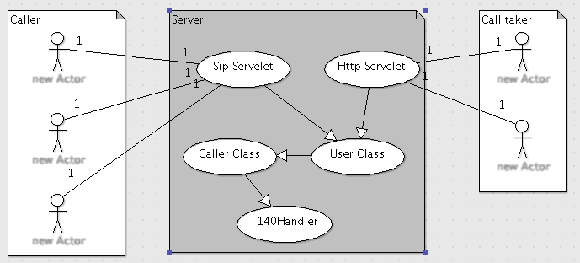
Architecture (1)

Slide 4
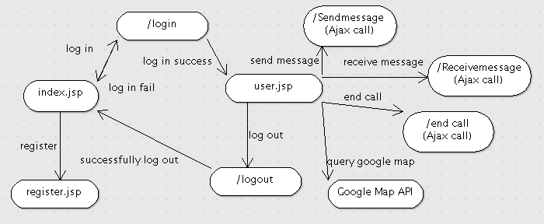
Architecture (2)

Slide 5
Web interface (1)
To enable username and password login for security purposes.
  User can register a username one the sever and use it to log in.
  Use seesion to store information when user log in.
  Clear the seesion and log user out when user close the browser tab/window.
  If the server does not receive any request from a user within 5 minutes, server will log the user out.
To notify a call taker about a new incoming message.
  The caller tab will show yellow color when receiving a new message from the caller.

Slide 6
Web interface (2)
To provide an interface for call takers to chat with callers
  Support instant messaging and real-time texting types of chat interface for the call taker.
Show the image sent by caller.
  Provide a thumbnail of the image. click it will open a new window with the real size image.
Provide text format of the caller’s information
  name, ip, message type(RTT or SIP), location (longitude, latitude)
To point the location of the emergency caller on the Google Map on the web Interface.
  Use a marker on google map to show the position of the caller.

Slide 7
Future work
Traffic on the server.
Support RTT and Instant message from the same person at the same time.
Log everything and save them to database.
Refine the user interface.
Include and extract the phone number from the header.

