Slide 1
An Overview of Active NetworkS
Adam Zhang
az2163@columbia.edu

Slide 2
Agenda
Introduction
The papers:
  Technical overviews
  Active network architectures
  Resource & network management
  Security
  The nodeOS
  Commercial viability
Criticism and decline of AN research
Current network architecture research
Conclusion

Slide 3
Introduction
1994-95 : Defense Advanced Research Projects Agency (DARPA)
Future directions of networking
Problems with the current Internet architecture:
  Integrating new technology, standards
  Redundant operations -> poor performance
  Adding new services
Active networking emerged

Slide 4
Technical Overviews
D. L. Tennenhouse and D. Wetherall. Towards an Active Network Architecture. In Multimedia Computing and Networking 96, San Jose, CA, Jan. 1996. A revised version appears in CCR Vol. 26, No. 2 (April 1996).
** 2007 Sigcomm Test-of-Time Award Recipient**
David L. Tennenhouse, Jonathan M. Smith, W. David Sincoskie, David J. Wetherall, and Gary J. Minden. A Survey of Active Network Research. IEEE Communications Magazine, 35(1):80-86, January 1997.
Ken Calvert. Reflections on network architecture: an active networking perspective. In ACM SIGCOMM Computer Communication Review, pages 27-30, volume 36, issue 2, April 2006.

Slide 5
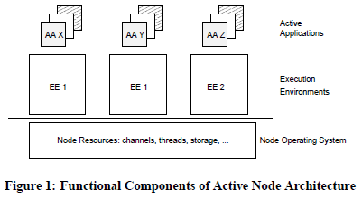
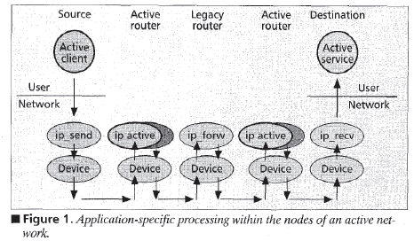
Technical Overviews (cont’d)
From “Reflections on Network Architecture”
From “A Survey of Active Network Research”

Slide 6
Active network architectures
D. Wetherall. Active network vision and reality: lessons from a capsule-based system. In Proceedings of the 17th ACM Symposium on Operating Systems Principles, pages 64-79, December 1999. (ANTS)
D. Scott Alexander, William A. Arbaugh, Michael W. Hicks, et al. The SwitchWare Active Network Architecture. IEEE Network Special Issue on Active and Controllable Networks, vol. 12 no. 3, pp. 29 - 36, July 1998.
Y. Yemini and S. da Silva. Towards Programmable Networks. In Intl. Work. on Dist. Systems Operations and Management, Italy, Oct. 1996.
Others: Smart packets, CANES, RANI

Slide 7
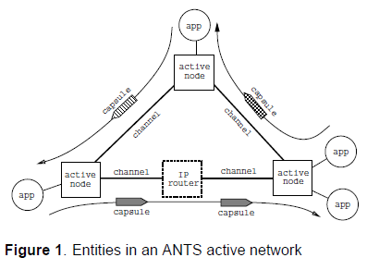
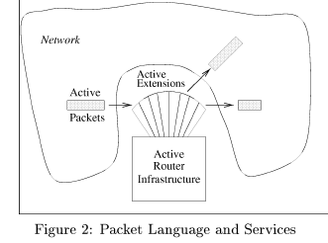
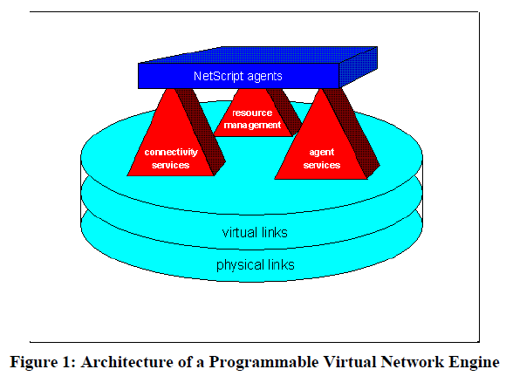
AN architectures (cont’d)
From “AN vision and reality”
From “The SwitchWare Active Network Architecture”
Architecture | Language for Apps | Approach
ANTS | Java | Capsule
SwitchWare | PLAN, Caml | Programmable-switch
NetScript | NetScript | Programmable-switch
From “Towards Programmable Networks”

Slide 8
Resource & Network Management
K. Vimala Devi, K.M. Mehata, and S. Radhakrishnan. Resource prediction and management in active networks. In International Journal of Network Management, pages 57-74, volume 19 issue 1, January 2009.
N. Prahavalkar and M. Parashar. Controlling unresponsive connections in an active network architecture. In Journal of Network Management, pages 289-305, volume 13 issue 4, July 2003.
D. Raz and Y. Shavitt. An Active Network Approach to Efficient Network Management. In Proceedings of the First International Working Conference on Active Networks, pages 220-231, 1999.

Slide 9
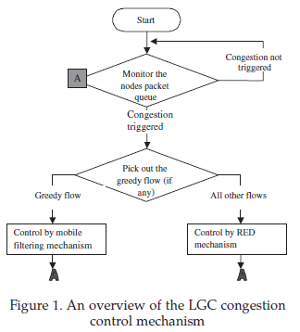
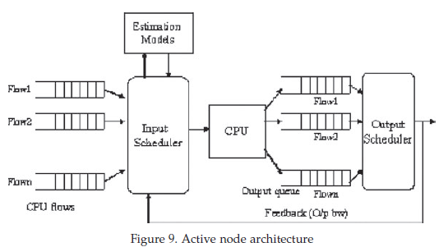
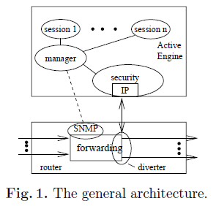
Resource & Network Mgmt (cont’d)
From “Resource prediction and mgmt”
From “Controlling unresponsive connections”
Algorithm | Purpose | Methods | Test bed
LGC | Controlling unresponsive connections | RED, mobile filtering | RANI
CPU scheduler | CPU, bandwidth mgmt | Estimation techniques | NS-2 network simulator

Slide 10
Security
S. Murphy, E. Lewis, R. Watson, and R. Yee. Strong Security for Active Networks. In IEEE Open Architectures and Network Programming Proceedings, pages 63-70, April 2001.
Z. Liu and R. Campbell. Active Security Support for Active Networks. In IEEE Transactions on Systems, Man, and Cybernetics, Part C: Applications and Reviews, pages 432-445, November 2003.

Slide 11
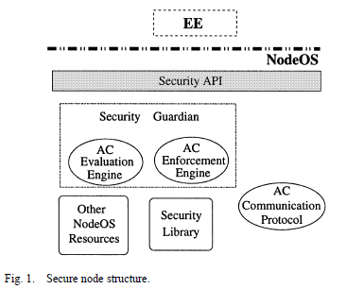
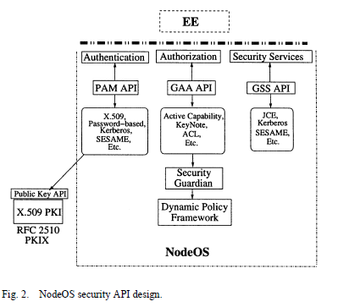
Security (cont’d)
From “Active Security Support”

Slide 12
The nodeOS
Paptrick Tullmann, Mike Hibler, Jay Lepreau. Janos: A Java-Oriented OS for Active Network Nodes. pp.117, 2002 DARPA Active Networks Conference and Exposition (DANCE'02), 2002
L. Peterson, Y. Gottlieb, et al. An OS interface for active routers. In IEEE Journal on Selected Areas in Communications, pages 473-487, March 2001.
Others: Scout, Exokernel, SPIN, ‘C

Slide 13
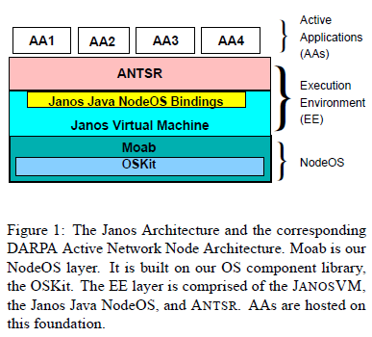
The nodeOS (cont’d)
From “Janos: A Java-oriented OS”

Slide 14
Commercial Viability
S. Eichert, O. Ertugay, D. Nessett, and S. Vobbilisetty. Commercially Viable Active Networking. In ACM SIGOPS Operating Systems Review, pages 8-22, January 2002.

Slide 15
Criticism and decline of AN research
End of DARPA program -> Active network research almost non-existent by early 2000’s.
Many possible implementations, no “winner”
No way to test on a large scale
Focus was on the node, not on end-to-end services
Can’t measure long-term benefits
Security risk

Slide 16
Current network architecture research
GENI
NetServ

Slide 17
Conclusion
Active networking was a novel idea that created a lot of interest
Research in many different areas took place from about 1996-2001.
Next generation of Internet architecture may draw from AN

