Slide 1
HIP & MIPv6 Security
Research: Security Architecture

Slide 2
Overview
SINE architecture
Control functions for each networking layer
Decoupling of Service and Infrastructure functionality
SINE specific security challenges
Network Access (discovery – trust establishment)
End-to-end Communications
Mobility Management
Notes:
Mobility Management special

Slide 3
Security challenges on Mobility
Notes:
Happens when the MN moves from one network to another network

Slide 4
Security Implementation
Credential Management
Secure Connections
Mobility Management

Slide 5
Credential Management
HIP
Host Identity (public key of the certificate)
Host Identity Tag (HIT) -> IP address (HIP address)
Host Identity Hash function (HIH) -> 128/32 bits
libcrypto
Mobile IPv6
Home Address
IPv6Sec
Notes:
When changing service provider, different IP address -> universal credential
HIP: self-signed
MIPv6: leverage IPSec. Where to get HoA?

Slide 6
Secure Connections
HIP
HI -> DH -> Symmetric key
Resistant to DoS and MitM
Data encryption (ESP)
Secure channel between any peer pair
libssl
Mobile IPv6
Secure channel between MN and HA
IPv6Sec

Slide 7
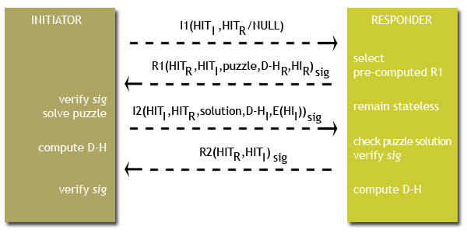
Secure Connections : HIP
source: http://wireless.arcada.fi/MOBWI/material/HM_1_2.html
Notes:
MIPv6 : IPSec
Control v.s. data channel
HIP creates a secure data channel in the meantime
MIPv6 has no secure data channel, only optional secure control channel
Asymmetric -> symmetric

Slide 8
Mobility Management
HIP
Binding Update / Acknowledgement between peers
Rendezvous Server (RVS) to maintain bindings
Mobile IPv6
Home Agent (HA) to maintain bindings
Binding Update / Acknowledgement between MN and HA
Routing Optimization (no a priori secure control channel between MN and CN)
Notes:
RO: Home Test Init (HoTI), Care-of Test Init

Slide 9
Next Steps
Security paper
Decouple the control-plane implementation in HIP
data-plane security
Notes:
Controled by middleware

