Slide 1
SCTP vs. MPTCP: Evaluating Concurrent Multipath Protocols
Anthony Trinh and Rich Zieminski
Department of Computer Science, Columbia University
{ akt2105, rez2107 }@columbia.edu

Slide 2
Motivation
Content changes require new access methods
Larger content
Different Content
Greater reliability
Concurrent Multipath Transfer using Stream Control Transmission Protocol (CMT-SMTP)
Multipath Transmission Control Protocol (MPTCP)

Slide 3
SCTP vs. MPTCP
Multi-Stream Protocol
Message Oriented (Multi-byte chucks)
Out of order delivery
Multi-home capable
Failover Supported
Transport Layer
Application code changes required
Processor Intensive
Multi-Stream Protocol
Multi-home capable
Failover Supported
Backward compatible with TCP
Requires code changes to utilize full potential
Potential for higher delay and jitter
Requires network stack modifications
SCTP
MPTCP

Slide 4
EMULAB
An OS for Network Testbeds
Wired and wireless test nodes
Multiple OS’s, various hardware
Configurable routing schemes
Configured using common simulation tools
The Network Simulator 2(ns-2)

Slide 5
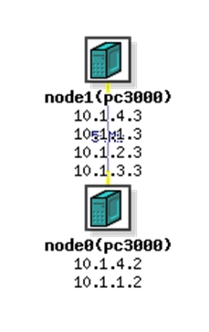
EMULAB
Testing Environment/Setup
Technology | Bandwidth (Mbit/s) |  | Delay (ms) | Packet Loss Ratio (%)
 | Downlink | Uplink
Ethernet (ref) | 100 | 100 | 2 | 1
4G-LTE | 100 | 100 | 30 | 5
3G-HSPA+ | 56 | 22 | 80 | 9
802.11g | 54 | 54 | 2 | 2
Emulated Network Topology
Sample ns-2 script
Node configuration
Ethernet (lan0)
Delay Node (wlan1)
Server (node1)
Client (node0)
Delay Node (wlan2)
Delay Node (wlan3)

Slide 6
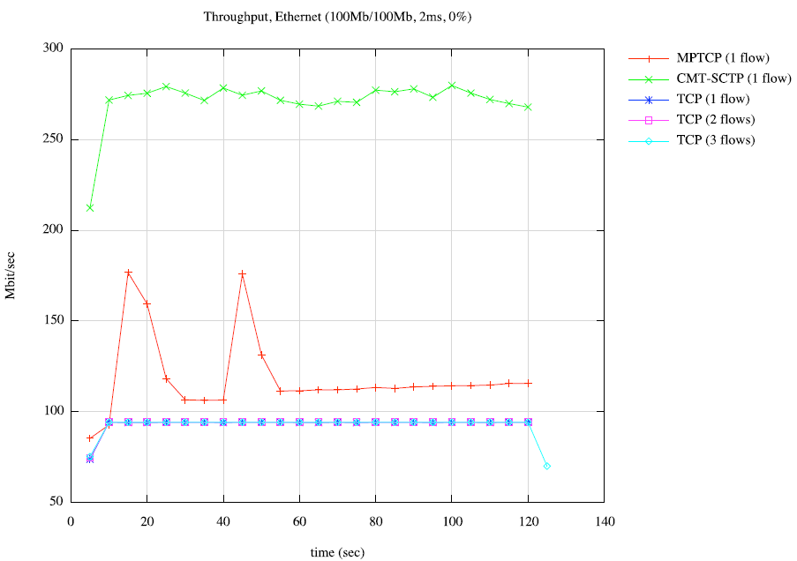
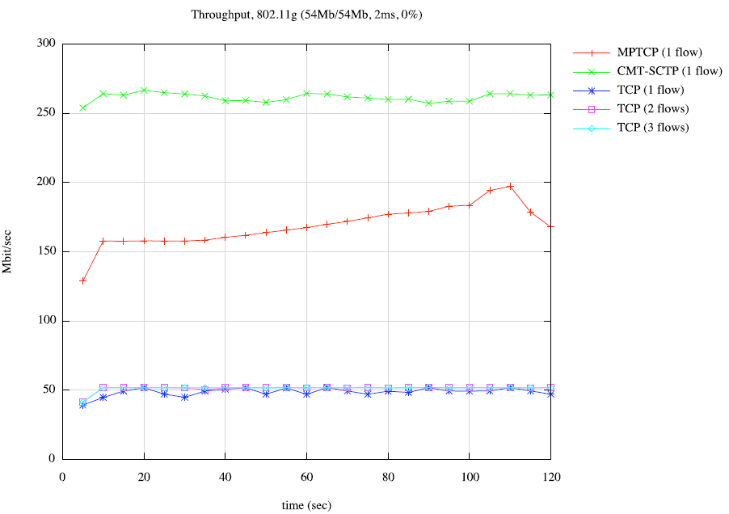
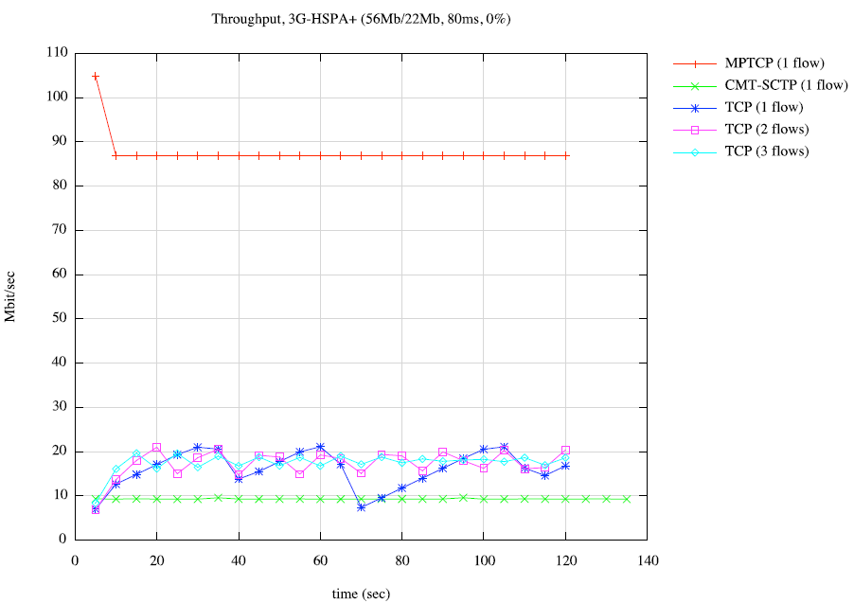
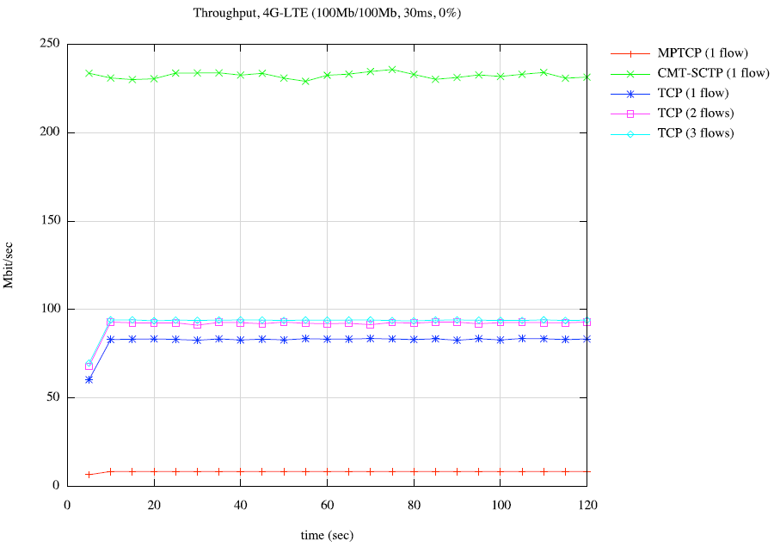
Results, Throughput

Slide 7
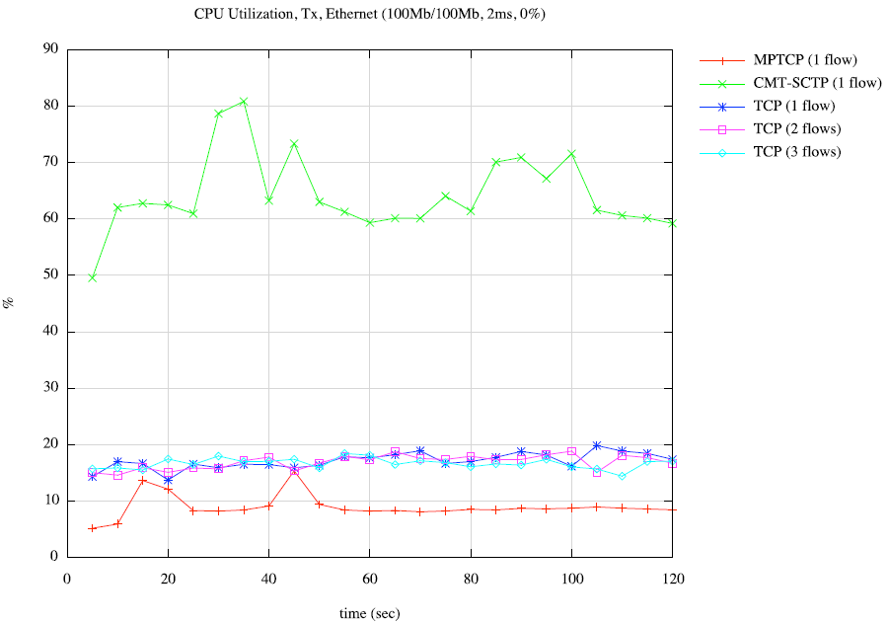
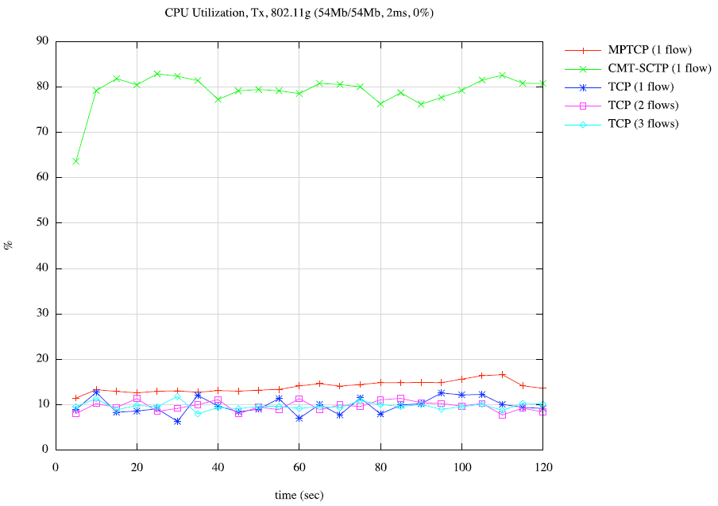
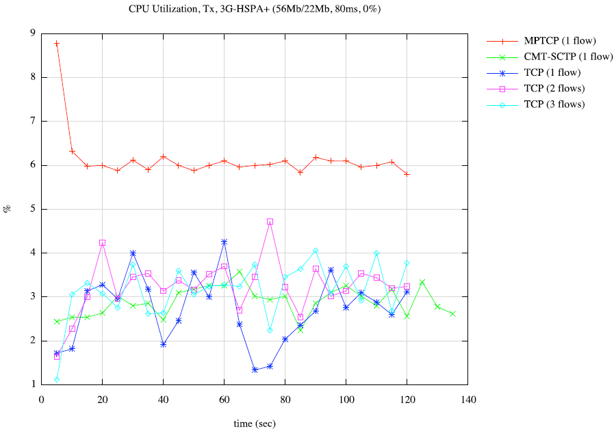
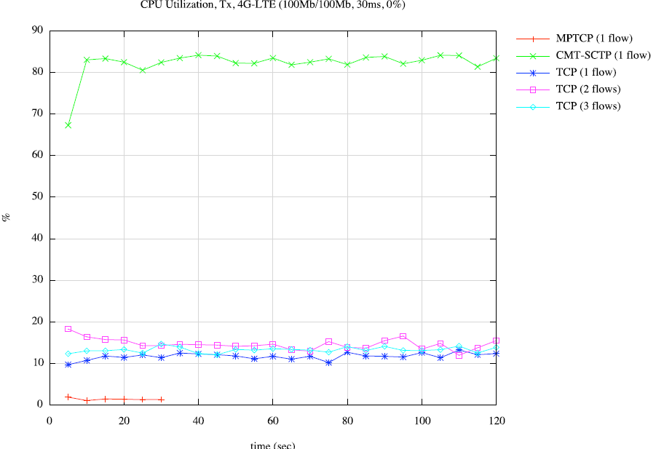
Results, TX CPU Utilization

Slide 8
Summary
Future Work
Varied message size testing
Test other performance metrics
Delay, Jitter
Real application performance
Link Aggregation
Redundant links (fault tolerant)
Recovery time after failure

