Slide 1
CS E6998-1: Advanced Topics in Programming Languages and Compilers
Alfred V. Aho
aho@cs.columbia.edu
Lecture 1 – Introduction to Course
September 8, 2014

Slide 2
Lecture Outline
Introduction to course
Course overview
Prerequisites and background text
Course project and grading
Software and programming languages
The implementation of programming languages
Lambda calculus − an overview

Slide 3
1. Introduction to Course
Professor Al Aho
http://www.cs.columbia.edu/~aho
aho@cs.columbia.edu
Lectures: Mondays, 4:10-6:00pm, 253 ENG
Office hours: Mondays 3:00-4:00pm,
513 Computer Science Building
Course webpage: http://www.cs.columbia.edu/~aho/cs6998

Slide 4
2. Course Overview
This will be a seminar-based course focused on advanced topics in programming languages and compilers
A highlight of this course is a semester-long project in which you can explore an advanced topic of your own choosing in more depth
Topics can include
Studies of new programming languages and their features
New techniques for program translation and optimization
Program analysis techniques and tools for software robustness
The course requirements are two 30-minute in-class presentations and a final project report

Slide 5
Course Objectives
Understanding how language and compiler technology can be used to make safer software more reliably and quickly
Learning the advanced concepts and design principles underlying modern programming languages
Understanding program analysis techniques and tools
Harnessing language and compiler technology in dealing with parallelism and concurrency
Experiencing an in-depth project exploring modern language and compiler techniques

Slide 6
Course Syllabus
Language design
Language features
Lambda calculus and functional languages
Program analysis and optimization techniques
Interprocedural analysis
Pointer analysis
Binary decision diagrams
SAT and SMT solvers
Model checking and abstract interpretation
Concurrency and parallelism

Slide 7
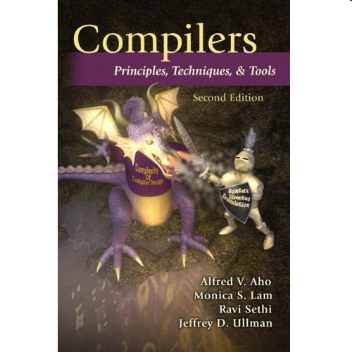
3. Prerequisites and Background Text
Fluency in at least one major programming language such as C, C++, C#, Java, OCaml, or Python
COMS W4115: Programming Languages and Translators, or equivalent
Text: Compilers, Techniques, and Tools
(Second Edition), Aho, Lam, Sethi, and
Ullman, Addison-Wesley, 2007

Slide 8
4. Course Project and Grade
Each student should select by 9/22/14 a semester-long programming language or compiler project to pursue in more depth. Teams of two are permitted if desired.
Each student will give two 30-minute presentations to the class
At the end of the semester, students will submit a final project report summarizing their project.
The project and classroom discussions will determine the final grade:
50% for the two presentations
50% for the final project report

Slide 9
Potential Project Topics
Detailed report on a new PL such as Swift or Java 8
New features being added to legacy PLs
Advanced program analysis and optimization techniques
Solver-aided languages
Verifying compilers
Abstract interpretation and model checking
Regular expression pattern matching in PLs
Applications of category theory to PLs
Insecure constructs in PLs and how to overcome them
Report on a “most influential PLDI paper”
http://www.sigplan.org/Awards/Conferences/PLDI/Main.htm

Slide 10
Recent Most Influential PLDI Papers
Scalable lock-free dynamic memory allocation
The nesC language: a holistic approach to networked embedded systems
Extended static checking for Java
Automatic predicate abstraction of C programs
Dynamo: A transparent dynamic optimization system
A fast Fourier transform compiler
The implementation of the Cilk-5 multithreaded language
Exploiting hardware performance counters with flow and context sensitive profiling
TIL: A type-directed optimizing compiler for ML
Selective specialization for object-oriented languages
[http://www.sigplan.org/Awards/Conferences/PLDI/Main]

Slide 11
5. Software and Programming Languages
How much software does the world use today?
Guesstimate: around one trillion lines of source code
What is the sunk cost of the legacy software base?
$100 per line of finished, tested source code
How many bugs are there in the legacy base?
10 to 10,000 defects per million lines of source code
Notes:
Why programming language design? Well it’s because of software. Here is the first of three questions I use to begin by PL&C course at Columbia.
Bottom line: very few people appreciate the importance of software in the world today, how much money has been invested in software, and how fragile our software legacy base is.

Slide 12
Issues in Programming Language Design
Domain of application
exploit domain restrictions for expressiveness, performance
Computational model
simplicity, ease of expression
Abstraction mechanisms
reuse, suggestivity
Type system
reliability, security
Usability
readability, writability, efficiency, learnability, scalability, portability

Slide 13
Kinds of Languages - I
Declarative
Program specifies what computation is to be done
Examples: Haskell, ML, Prolog
Domain specific
Many areas have special-purpose languages for creating applications
Examples: Lex for scanners, Yacc for parsers
Functional
One whose computational model is based on lambda calculus
Examples: Haskell, ML

Slide 14
Kinds of Languages - II
Imperative
Program specifies how a computation is to be done
Examples: C, C++, C#, Fortran, Java
Markup
One designed for the presentation of text
Usually not Turing complete
Examples: HTML, XHTML, XML
Object oriented
Program consists of interacting objects
Uses encapsulation, modularity, polymorphism, and inheritance
Examples: C++, C#, Java, OCaml, Smalltalk

Slide 15
Kinds of Languages - III
Parallel
One that allows a computation to run concurrently on multiple processors
Examples: CUDA, Cilk, MPI, POSIX threads, X10
Scripting
An interpreted language with high-level operators for “gluing together” computations
Examples: Awk, Perl, PHP, Python, Ruby
von Neumann
One whose computational model is based on the von Neumann architecture
Computation is done by modifying variables
Examples: C, C++. C#, Fortran, Java

Slide 16
Major Application Areas - I
Big data
C++, Python, R, SQL, and Hadoop-based languages
Scientific computing
Fortran, C++
Scripting applications
Awk, Perl, Python, Tcl
Specialized applications
LaTex for typesetting
SQL for database applications
VB macros for spreadsheets

Slide 17
Major Application Areas - II
Symbolic programming
F#, Haskell, Lisp, ML, Ocaml
Systems programming
C, C++, C#, Java, Objective-C
Web programming
CGI
HTML
JavaScript
Ruby on Rails
Countless other application areas

Slide 18
What are Today’s Most Popular PLs?
tiobe.com
C
Java
Objective-C
C++
Basic
C#
Python
PHP
Perl
JavaScript
[www.tiobe.com,
August 2014
Data from search engines]
PyPL Index
Java
PHP
Python
C#
C++
C
Javascript
Objective-C
Ruby
Basic
[PyPL Index,
August 2014
Tutorial searches
on Google]
RedMonk
Java/JavaScript
PHP
Python
C#
C++/Ruby
CSS
C
Objective-C
[redmonk.com,
June 2014
Data from GitHub]
StackOverflow
Java
C#
JavaScript
PHP
Python
C++
SQL
Objective-C
C
Ruby
[langpop.corger.nl,
August 2014
Data from GitHub]
Notes:
Since all software systems are written in a programming language, let’s look at how programming languages have changed over the last forty years. Here are a variety of programming language indexes for 2014. Although the popular languages have changed, there is still a lot of software being developed and maintained today with the old languages like Fortran and Cobol.

Slide 19
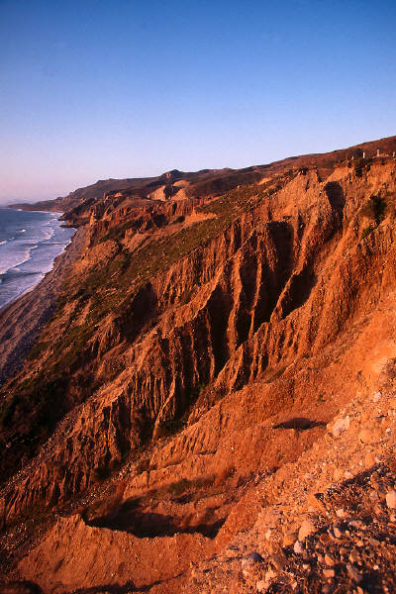
Evolutionary Forces Driving PL Changes
Increasing diversity of applications
Stress on increasing programmer productivity and shortening time to market
Need to improve software security, reliability and maintainability
Emphasis on mobility and distribution
Support for parallelism and concurrency
New mechanisms for modularity and scalability
Trend toward multi-paradigm programming
Notes:
New languages are being created regularly. Even the existing languages like C and Java undergo substantial revisions with each new version. There are several powerful forces driving these changes.

Slide 20
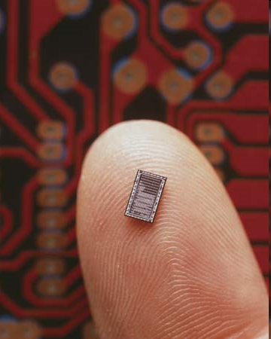
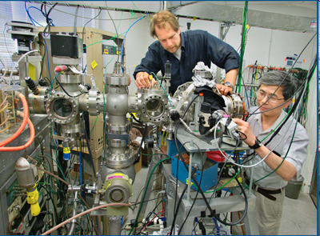
Target Languages and Machines
Another programming language
CISCs
RISCs
Parallel machines
Multicores
GPUs
Quantum computers

Slide 21
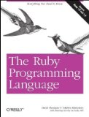
Case Study 1: Ruby
Ruby is a dynamic, OO scripting language designed by Yukihiro Matsumoto in Japan in the mid 1990s
Characteristics: object oriented, dynamic, designed for the web, scripting, reflective
Supports multiple programming paradigms including functional, object oriented, and imperative
The three pillars of Ruby
everything is an object
every operation is a method call
all programming is metaprogramming
Made popular by the web application framework Rails
http://www.ruby-lang.org/en/about/
Notes:
Another very popular new language for developing web applications is Ruby. You can think of it as a pure OO replacement for Perl.

Slide 22
Case Study 2: Scala
Scala is a multi-paradigm programming language designed by Martin Odersky at EPFL starting in 2001
Characteristics: scalable, object oriented, functional, seamless Java interoperability, functions are objects, future-proof, fun
Integrates functional, imperative and object-oriented programming in a statically typed language
Functional constructs used for parallelism and distributed computing
Generates Java byte code
Used to implement Twitter
Katy Perry has 54 million followers
Barack Obama has 44 million followers
[http://twitaholic.com/]
http://www.scala-lang.org/what-is-scala.html
Notes:
One of the much talked about new languages of the last two decades is Scala.

Slide 23
How Many PLs are There?
Guesstimate: thousands
The website http://www.99-bottles-of-beer.net
has programs in over 1,500 different
programming languages and variations to print
the lyrics to the song “99 Bottles of Beer.”
Notes:
There are as many programming languages in the world today as there are natural languages. There is a website at Murdoch University in Australia that apparently lists over 8000 programming languages. However, what’s more fun is the website “99 bottles of beer.”

Slide 24
“99 Bottles of Beer”
99 bottles of beer on the wall, 99 bottles of beer.
Take one down and pass it around, 98 bottles of beer on the wall.
98 bottles of beer on the wall, 98 bottles of beer.
Take one down and pass it around, 97 bottles of beer on the wall.
.
.
.
2 bottles of beer on the wall, 2 bottles of beer.
Take one down and pass it around, 1 bottle of beer on the wall.
1 bottle of beer on the wall, 1 bottle of beer.
Take one down and pass it around, no more bottles of beer on the wall.
No more bottles of beer on the wall, no more bottles of beer.
Go to the store and buy some more, 99 bottles of beer on the wall.
[Traditional]
Notes:
In case you are not familiar with song “99 bottles of beer” here are its lyrics. As you can see, it is a drinking song.

Slide 25
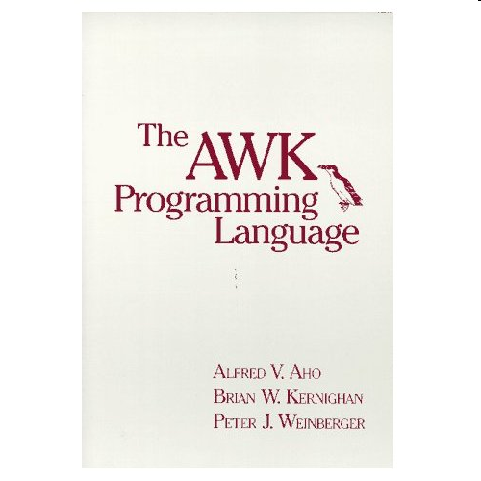
“99 Bottles of Beer” in AWK
BEGIN {
for(i = 99; i >= 0; i--) {
print ubottle(i), "on the wall,", lbottle(i) "."
print action(i), lbottle(inext(i)), "on the wall."
print
}
}
function ubottle(n) {
return sprintf("%s bottle%s of beer", n ? n : "No more", n - 1 ? "s" : "")
}
function lbottle(n) {
return sprintf("%s bottle%s of beer", n ? n : "no more", n - 1 ? "s" : "")
}
function action(n) {
return sprintf("%s", n ? "Take one down and pass it around," : \
"Go to the store and buy some more,")
}
function inext(n) {
return n ? n - 1 : 99
}
[Osamu Aoki, http://people.debian.org/~osamu]
Notes:
On this website there is a program to print the lyrics of 99 bottles of beer in one of my favorite languages – AWK.

Slide 26
“99 Bottles of Beer” in Perl
''=~( '(?{' .('`' |'%') .('[' ^'-')
.('`' |'!') .('`' |',') .'"'. '\\$'
.'==' .('[' ^'+') .('`' |'/') .('['
^'+') .'||' .(';' &'=') .(';' &'=')
.';-' .'-'. '\\$' .'=;' .('[' ^'(')
.('[' ^'.') .('`' |'"') .('!' ^'+')
.'_\\{' .'(\\$' .';=('. '\\$=|' ."\|".( '`'^'.'
).(('`')| '/').').' .'\\"'.+( '{'^'['). ('`'|'"') .('`'|'/'
).('['^'/') .('['^'/'). ('`'|',').( '`'|('%')). '\\".\\"'.( '['^('(')).
'\\"'.('['^ '#').'!!--' .'\\$=.\\"' .('{'^'['). ('`'|'/').( '`'|"\&").(
'{'^"\[").( '`'|"\"").( '`'|"\%").( '`'|"\%").( '['^(')')). '\\").\\"'.
('{'^'[').( '`'|"\/").( '`'|"\.").( '{'^"\[").( '['^"\/").( '`'|"\(").(
'`'|"\%").( '{'^"\[").( '['^"\,").( '`'|"\!").( '`'|"\,").( '`'|(',')).
'\\"\\}'.+( '['^"\+").( '['^"\)").( '`'|"\)").( '`'|"\.").( '['^('/')).
'+_,\\",'.( '{'^('[')). ('\\$;!').( '!'^"\+").( '{'^"\/").( '`'|"\!").(
'`'|"\+").( '`'|"\%").( '{'^"\[").( '`'|"\/").( '`'|"\.").( '`'|"\%").(
'{'^"\[").( '`'|"\$").( '`'|"\/").( '['^"\,").( '`'|('.')). ','.(('{')^
'[').("\["^ '+').("\`"| '!').("\["^ '(').("\["^ '(').("\{"^ '[').("\`"|
')').("\["^ '/').("\{"^ '[').("\`"| '!').("\["^ ')').("\`"| '/').("\["^
'.').("\`"| '.').("\`"| '$')."\,".( '!'^('+')). '\\",_,\\"' .'!'.("\!"^
'+').("\!"^ '+').'\\"'. ('['^',').( '`'|"\(").( '`'|"\)").( '`'|"\,").(
'`'|('%')). '++\\$="})' );$:=('.')^ '~';$~='@'| '(';$^=')'^ '[';$/='`';
[Andrew Savage, http://search.cpan.org/dist/Acme-EyeDrops/lib/Acme/EyeDrops.pm]
Notes:
Here is a perl program on the website to print the lyrics. I actually compiled and ran this program. It does print out the lyrics!

Slide 27
“99 Bottles of Beer” in the Whitespace Language
[Andrew Kemp, http://compsoc.dur.ac.uk/whitespace]
Notes:
And here is a program in the Whitespace language to print out the lyrics. The Whitespace language only uses blanks, tabs and linefeeds as input characters.

Slide 28
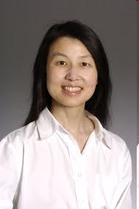
Computational Thinking – Jeannette Wing
Computational thinking is a fundamental skill for everyone, not just for computer scientists. To reading, writing, and arithmetic, we should add computational thinking to every child’s analytical ability. Just as the printing press facilitated the spread of the three Rs, what is appropriately incestuous about this vision is that computing and computers facilitate the spread of computational thinking.
Computational thinking involves solving problems, designing systems, and understanding human behavior, by drawing on the concepts fundamental to computer science. Computational thinking includes a range of mental tools that reflect the breadth of the field of computer science.
[Jeannette Wing, Computational Thinking, CACM, March, 2006]

Slide 29
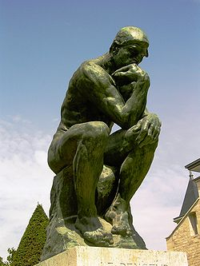
What is Computational Thinking?
The thought processes involved in formulating a problem and expressing its solution in a way that a computer − human or machine − can effectively carry it out
A. V. Aho
Computation and Computational Thinking
The Computer Journal 55:12, pp. 832-835, 2012
Jeannette M. Wing
Joe Traub 80th Birthday Symposium
Columbia University, November 9, 2012
Notes:
In a recent talk at Columbia, Jeannette Wing liked my definition and improved it by making the human element explicit.

Slide 30
Computational Thinking in Language Design
Problem
Domain
Mathematical
Abstraction
Computational
Model
Programming
Language

Slide 31
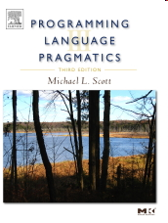
Common Models of Computation in PLs
PLs are designed around a model of computation:
Procedural: Fortran (1957)
Functional: Lisp (1958)
Object oriented: Simula (1967)
Logic: Prolog (1972)
Relational algebra: SQL (1974)
Notes:
Programming languages are usually designed around some model of computation. Here are some of the most important ones.

Slide 32
Computational Model Underlying AWK
AWK is a scripting language designed to perform routine data-processing tasks on strings and numbers
Use case: given a list of name-value pairs, print the total value associated with each name.
An AWK program
is a sequence of
pattern-action statements
alice 10
eve 20
bob 15
alice 30
{ total[$1] += $2 }
END { for (x in total) print x, total[x] }
eve 20
bob 15
alice 40
Notes:
A long time ago when I was at Bell Labs I with Brian Kernighan and Peter Weinberger developed a little language for processing data that got to be known as AWK. AWK uses a pattern-action model of computation. An AWK program is of a sequence of pattern-action statements. The program reads the input a line at a time. A line is scanned for each pattern in the program, and for each pattern that matches, the associated action is executed.
Here is a two-line AWK program that reads a sequence of name-value pairs and for each name accummates the total value.
AWK became a utility on the UNIX operating system that was developed in the research center at Bell Labs where we worked. It soon became one of the ten most popular programs on UNIX because people could easily learn the language and one of the most common initial uses of it was to transform the output of one Unix program into a form so that it could be piped into another program.
AWK was inspired by the Unix program grep, and it provided inspiration for Larry Wall to develop the Perl programming language.

Slide 33
What does this AWK program do?
!x[$0]++
Maybe a little less cryptic:
!seen[$0]++
/* Both programs print the unique lines of the input. */

Slide 34
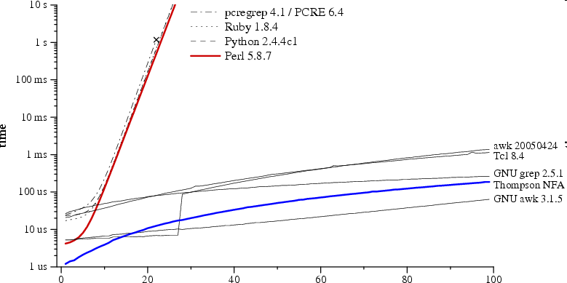
Theory in practice: regular expression pattern matching in Perl, Python, Ruby vs. AWK
Running time to check whether a?^{n}a^{n} matches a^{n}
regular expression and text size n
Russ Cox, Regular expression matching can be simple and fast (but is slow in Java, Perl, PHP, Python, Ruby, ...) [http://swtch.com/~rsc/regexp/regexp1.html, 2007]
Notes:
Another feature of AWK is that it used theory to do the pattern matching. At that time I was interested in efficient string matching algorithms and I incorporated one of my regular expression pattern matching algorithms into AWK. I was strongly influenced by Donald Knuth’s dictum that “the best theory is inspired by practice and the best practice is inspired by theory.” It’s unfortunate that Larry Wall who created Perl was not so inclined.

Slide 35
The Specification of PLs
Syntax
Semantics
Pragmatics
However, a precise, automatable, easy-to-understand, easy-to-implement method for specifying a complete language is still an open research problem

Slide 36
Grammars are Used to Help Specify Syntax
The grammar S → aSbS | bSaS | ε generates all strings of a’s and b’s with the same number of a’s as b’s.
This grammar is ambiguous: abab has two parse trees.
S
S
a
S
b
S
a
S
b
S
b
S
a
S
ε
ε
a
S
b
S
ε
ε
ε
ε
(ab)^{n} has parse trees

Slide 37
Natural Languages are Inherently Ambiguous
I made her duck.
[5 meanings: D. Jurafsky and J. Martin, 2000]
One morning I shot an elephant in my pajamas. How he got into my pajamas I don’t know.
[Groucho Marx, Animal Crackers, 1930]
List the sales of the products produced in 1973 with the products produced in 1972.
[455 parses: W. Martin, K. Church, R. Patil, 1987]

Slide 38
Programming Languages are not Inherently Ambiguous
This grammar G generates the same language
S → aAbS | bBaS | ε
A → aAbA | ε
B → bBaB | ε
G is unambiguous and has
only one parse tree for
every sentence in L(G).
S
a
A
b
S
ε
a
A
b
S
ε
ε

Slide 39
Methods for Specifying the Semantics of Programming Languages
Operational semantics
Program constructs are translated to an understood language.
Axiomatic semantics
Assertions called preconditions and postconditions specify
the properties of statements.
Denotational semantics
Semantic functions map syntactic objects to semantic values.

Slide 40
6. The Implementation of PLs
Compilers
Interpreters
Just-in-time compilers
Compiler collections such as GCC and LLVM

Slide 41
Phases of a Compiler
source
program
target
program
Lexical
Analyzer
Syntax
Analyzer
Semantic
Analyzer
Interm.
Code
Gen.
Code
Optimizer
Code
Gen.
token
stream
syntax
tree
annotated
syntax
tree
interm.
rep.
interm.
rep.
Symbol Table
[A. V. Aho, M. S. Lam, R. Sethi, J. D. Ullman, Compilers: Principles, Techniques, & Tools, 2007]

Slide 42
Compiler Component Generators
lex
specification
yacc
specification
Lexical
Analyzer
Generator
(lex)
Syntax
Analyzer
Generator
(yacc)
Lexical
Analyzer
Syntax
Analyzer
source
program
token
stream
syntax
tree

Slide 43
Lex Specification for a Desk Calculator
number [0-9]+\.?|[0-9]*\.[0-9]+
%%
[ ] { /* skip blanks */ }
{number} { sscanf(yytext, "%lf", &yylval);
return NUMBER; }
\n|. { return yytext[0]; }
[M. E. Lesk and E. Schmidt, Lex – A Lexical Analyzer Generator]

Slide 44
Yacc Specification for a Desk Calculator
%token NUMBER
%left '+'
%left '*'
%%
lines : lines expr '\n' { printf("%g\n", $2); }
| /* empty */
;
expr : expr '+' expr { $$ = $1 + $3; }
| expr '*' expr { $$ = $1 * $3; }
| '(' expr ')' { $$ = $2; }
| NUMBER
;
%%
#include "lex.yy.c"
[Stephen C. Johnson, Yacc: Yet Another Compiler-Compiler ]

Slide 45
Creating the Desk Calculator
Invoke the commands
lex desk.l
yacc desk.y
cc y.tab.c –ly –ll
Result
Desk
Calculator
1.2 * (3.4 + 5.6)
10.8

Slide 46
Some Computational Thinking Lessons Learned in COMS W4115
“Designing a language is hard and designing a simple language is extremely hard!”
“During this course we realized how naïve and overambitious we were, and we all gained a newfound respect for the work and good decisions that went into languages like C and Java which we’ve taken for granted for years.”

Slide 47
7. Lambda Calculus − An Overview
Lambda calculus was introduced in the 1930s by Alonzo Church as a mathematical system for defining computable functions.
Lambda calculus is equivalent in definitional power to that of Turing machines.
Lambda calculus serves as the computational model underlying functional programming languages.
Lisp was developed by John McCarthy in 1956 around lambda calculus.
ML, a general purpose functional programming language, was developed by Robin Milner in the late 1970s.
Haskell, considered by many as one of the purest functional programming languages, was developed by Simon Peyton Jones, Paul Houdak, Phil Wadler and others in the late 1980s and early 90s.
Features from lambda calculus such as lambda expressions have been incorporated into many widely used programming languages like C++ and Java 8.

Slide 48
Grammar for Lambda Calculus
The central concept in lambda calculus is an expression which can denote a function definition (called a function abstraction) or a function application.
expr → abstraction | application | (expr) | var | constant
abstraction → λ var . expr
application → expr expr
We can think of a lambda-calculus expression as a program which when evaluated returns a result consisting of another lambda-calculus expression.
For notational convenience, we have included constants that can be numbers and built-in functions. These are unnecessary – they can be simulated in pure lambda calculus.

Slide 49
Function Abstraction
A function abstraction, often called a lambda abstraction, is an expression defining a function.
It consists of a lambda followed by a variable, a period, and then an expression: λ var . expr
In the function λ var . expr, var is the formal parameter and expr the body.
We say λ var . expr binds var in expr.
Example
λx.y is a function abstraction.
The variable x after the λ is the formal parameter of the function.
The expression y after the period is the body of the function.

Slide 50
Function Application and Currying
A function application, often called a lambda application, consists of an expression followed by an expression: expr expr.
If f is a function and x an expression, then fx is a function application denoting the application of the function f to the argument x. All functions in lambda calculus are prefix.
If we want to apply a function to more than one argument, we can use a technique called currying. We can express the sum of 1 and 2 by writing ((+ 1) 2). The expression (+ 1) denotes the function that adds 1 to its argument. Thus ((+ 1) 2) means the function + is applied to the argument 1 and the result is a function that is applied to 2.

Slide 51
Lambda Calculus Conventions
As in ordinary mathematics, we can omit redundant parentheses to avoid cluttering up expressions so we often write ((+ 1) 2) as (+ 1 2) or even + 1 2.
Function application is left associative and application binds tighter than period.
Example: λx.fgx = (λx.(fg)x)
Example: (λx.λy.xy)λz.z = (λx.(λy.(xy)))λz.z
The body in a function abstraction extends as far to the right as possible.
Example: λx.+ x 1 = λx.(+ x 1)

Slide 52
Evaluating an Expression
A lambda calculus expression can be thought of as a program which can be executed by evaluating it. Evaluation is done by repeatedly finding a reducible expression (called a redex) and reducing it using a technique called beta reduction.
For example the lambda calculus expression
(+ (* 1 2) (* 3 4))
has two redexes:
(* 1 2) and (* 3 4)
If we choose to reduce the first redex and then the second and then the result, we get the following sequence of reductions:
(+ (* 1 2) (* 3 4)) → (+ 2 (* 3 4))
→ (+ 2 12) → 14

Slide 53
Free and Bound Variables
In lambda calculus all variables are local to function definitions.
In the function λx.x the variable x in the body of the definition (the second x) is bound because its first occurrence in the definition is λx.
In the expression (λx.xy), the variable x in the body of the function is bound and the variable y is free.

Slide 54
Examples of Free and Bound Variables
In the expression (λx.x)(λy.yx)
The variable x in the body of the leftmost expression is bound to the first lambda.
The variable y in the body of the second expression is bound to the second lambda.
The variable x in the body of the second expression is free (and independent of the x in the first expression).
In the expression (λx.xy)(λy.y)
The variable y in the body of the leftmost expression is free.
The variable y in the body of the second expression is bound to the second lambda.

Slide 55
The Set of Free Variables
Given an expression e, the following rules define FV(e), the set of free variables in e:
If e is a variable x, then FV(e) = {x}.
If e is of the form λx.y, then FV(e) = FV(y) − {x}.
If e is of the form xy, then FV(e) = FV(x) ∪ FV(y).
An expression with no free variables is said to be closed.

Slide 56
Renaming Bound Variables by Alpha Conversion
The name of a formal parameter in a function definition is arbitrary. We can use any variable to name a parameter, so that the function λx.x is equivalent to λy.y and λz.z. This kind of renaming is called alpha conversion.
Note that we cannot rename free variables in expressions.
Also note that we cannot change the name of a bound variable in an expression to conflict with the name of a free variable in that expression.

Slide 57
Substitution
The notation [y/x]e is used to indicate that y is to be substituted for all occurrences of x in the expression e.
The rules for substitution are as follows. We assume x and y are distinct variables.
For variables
[e/x]x = e
[e/x]y = y
For function applications
[e/x](f g) = ([e/x]f)([e/x]g)
For function abstractions
[e/x](λx.f)= λx.f
[e/x](λy.f)= λy.[e/x]f, provided y is not a free variable in e.

Slide 58
Evaluation of Function Applications by Beta Reductions
A function application fg is evaluated by substituting the argument g for the formal parameter in the body of the function definition f.
Example: (λx.x)y → [y/x]x = y
This substitution in a function application is called a beta reduction and we use a right arrow to indicate a beta reduction.

Slide 59
Function Application by Beta Reductions
If expr1 → expr2, we say expr1 reduces to expr2 in one step.
In general, (λx.e)g → [g/x]e means that applying the function (λx.e) to the argument expression g reduces to the function body [g/x]e after substituting the argument expression g for the function's formal parameter x in the function body e.
We use →* to denote the reflexive and transitive closure of →.

Slide 60
Eta Conversion and Beta Abstraction
The two lambda expressions (λx.+ 1 x) and (+ 1) are equivalent in the sense that these expressions behave in exactly the same way when they are applied to an argument − they add 1 to it. Eta conversion is a rule that expresses this equivalence.
In general, if x does not occur free in the function F, then (λx.F x) is eta convertible to F.
Example: (λx.+ 1 x) is eta convertible to (+ 1)
We will sometimes say + 1 y is a beta abstraction of (λx.+ x y)1. This is analogous to running beta reduction in reverse.

Slide 61
Evaluating Expressions using Renaming
When performing substitutions, we should be careful to avoid mixing up free occurrences of a variable with bound ones.
When we apply the function λx.e to an expression g, we substitute all occurrences of x in e with g. If there is a free variable in g named x, we rename the bound variable x to avoid any conflicts before doing the substitution.

Slide 62
Examples of Evaluating Expressions using Renaming
The expression (λx.(λy.xy))y) contains a bound y in the middle and a free y at the right. We can rename the bound variable y to a new variable, say z, to evaluate the expression with no name conflicts: (λx.(λy.xy))y) =
(λx.(λz.xz))y) → [y/x](λz.xz) = (λz.yz)
The body of the leftmost expression in
(λx.(λy.(x(λx.xy))))y
is (λy.(x(λx.xy))). In this body only the first x is free. Before substituting, we rename the bound variable y to z, say, to avoid confusing it with its free occurrence. Therefore we get the evaluation:
(λx.(λy.(x(λx.xy))))y = (λx.(λz(x(λx.xz))))y
→ [y/x](λz.(x(λx.xz))) = (λz.(y(λx.xz)))

Slide 63
Normal Forms
An expression containing no possible beta reductions is called a normal form.
A normal form expression has no redexes in it.
Examples of normal form expressions:
x where x is a variable
xe where x is a variable and e is a normal form expression
λx.e where x is a variable and e is a normal form expression

Slide 64
Remarkable Properties of Lambda Calculus
The expression (λz.z z)(λz.z z) does not have a normal form because it repeatedly evaluates to itself. We can think of this expression as a representation for an infinite loop.
A remarkable property of lambda calculus is that every expression has a unique normal form if one exists.
Lambda calculus is also Church-Rosser, meaning that reductions can be applied in any order. More formally, if w →* x and w →* y, then there always exists an expression z such that x →* z and y →* z.

Slide 65
Evaluation Strategies
An expression may contain more than one redex so there can be several reduction sequences. For example, the expression
(+ (* 1 2) (* 3 4))
can be reduced to normal form with the reduction sequence
(+ (* 1 2) (* 3 4))
→ (+ 2 (* 3 4))
→ (+ 2 12)
→ 14
or the sequence
(+ (* 1 2) (* 3 4))
→ (+ (* 1 2) 12)
→ (+ 2 12)
→ 14
As we pointed out above, the expression (λx.x x)(λx.x x) does not have a terminating sequence of reductions.

Slide 66
Reduction Order Can Matter
The expression (λy.λz.z)((λx.x x)(λx.x x)) can be reduced to the normal form λz.z by first applying the function (λy.λz.z) to the argument
((λx.x x)(λx.x x))
This reduction order, reducing the leftmost outermost redex, corresponds to normal form evaluation.
On the other hand, if we first try to reduce the leftmost innermost redex ((λx.x x)(λx.x x)), we discover it always reduces to itself. It does not have a terminating sequence of reductions. This reduction order corresponds to applicative order evaluation.

Slide 67
Normal Form Evaluation
In normal form evaluation we always reduce the leftmost redex of the outermost redex at each step.
If an expression has a normal form, then normal order evaluation will always find it.
Normal order evaluation is sometimes known as lazy evaluation.

Slide 68
Applicative Order Evaluation
In applicative order evaluation we always reduce the leftmost outermost redex whose argument is in normal form.
Actual parameters are evaluated before being passed to a function. Both the function and the argument are reduced before the argument is substituted into the body of the function.
Even though an expression may have a normal form, applicative order evaluation may fail to find it.
Applicative order is sometimes called eager evaluation.

Slide 69
Properties of Lambda Calculus
We can construct pure lambda calculus expressions (with no constants) to represent
integers (Church numerals)
0 = λf.λx.x
1 = λf.λx.f x
2 = λf.λx.f(f x)
arithmetic
succ = λn.λf.λx.f(n f x)
plus = λm.λn.λf.λx.m f(n f x)
booleans
true = λx.λy.x
false = λx.λy.y
logic
recursion
…

Slide 70
Recursion with the Y Combinator
The fixed-point Y combinator is a function that takes a function G as an argument and returns G(Y G).
With repeated applications we can get
G(G(Y G)), G(G(G(Y G))), . . .
We can implement recursive functions by defining the Y combinator:
Y = λf.(λx.f(xx))(λx.f(xx))
Note that
Y G = (λf.(λx.f(xx))(λx.f(xx)))G
→ (λx.G(xx))(λx.G(xx))
→ G((λx.G(xx))(λx.G(xx)))
= G(Y G)
The last line follows from Y G = (λx.G(xx))(λx.G(xx))

Slide 71
Summary
Lambda calculus is Turing complete
Lambda calculus is the model of computation underlying functional programming languages
References
Simon Peyton Jones, The Implementation of Functional Languages, Prentice-Hall, 1987
Stephen Edwards, The Lambda Calculus
http://www.cs.columbia.edu/~sedwards/classes/2014/w4115-summer-session/index.html

