Slide 1
BGDL
Board Game Design Language
COMS W4115: Programming Languages & Translators
Team 3:
Pilunchana Kiatruangkrai (Project Manager)
Janessa Det (Language & Tools Guru)
Beomjoong Kwon (System Architect)
Yang Sui (System Integrator)
Zi Li (Tester & Validator)

Slide 2
Introduction
Motivation
Create board game from scratch consumes time
Hard to modify
Monopoly board games are similar to each other
We love Monopoly board game!

Slide 3
BGDL = Board Game Design Language
Features
Automatically create complete
executable program with GUI
Modify Board, Player, Dice
Create arbitrary rules for each cell from “actions” provided

Slide 4
Development Process

Slide 5
Game Components
Board: title, width, height, player, dice
Board.title = "Monopoly!!";
Board.width = 6;
Board.height = 5;
Board.player = new Player[3];
Board.dice = new Dice[2];
Player: points, name, direction, location, delay
Board.player[2]=new Player(5000,"Player3",true,Cell[0, 2],0);
Dice: sides
Board.dice[0] = new Dice(6);

Slide 6
Game Components
Cell: GoTo, Change, Delay, Direction
GoTo(Player p, Cell location)
Change(Player p, int value)
Delay(Player p, int value)
Direction(Player p, boolean direction)
GameState:
numTurns
numPlayers
numRounds
currentPlayer
activePlayer
running

Slide 7
Designing a Game
void InitializeBoard()
Board.player = new Player[4];
void InitializeCells()
Cell[0,0] = { … };
boolean GameOver()
if( … ) { return true; }
else { return false; }
Player[] Winner()
Player[] winners = new Player[GameState.numPlayers];
…
return winners;

Slide 8
Game Engine
Game Libraries
Gameplay logic: Main.java
GUI: boardPanel.java, gamePanel.java, infoPanel.java
Interactive GUI Output

Slide 9
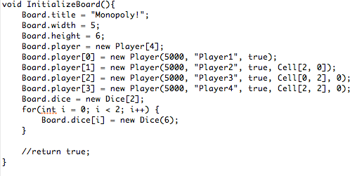
Translator Architecture
BGDLCode.bgdl
d
Java Libraries
Objects
GUI
BGDLLex.l
BGDLYacc.y
Board Game Application
Lexical
Analyzer
(JFlex)
Scanner
.java
Syntax
Analyzer
(BYACC)
Parser
.java
Semantic
Analyzer
(Type & Scope)
Java Code Generator
BoardGame
.java
Notes:
Also talk about Integration here.

Slide 10
Tools & Compilation
SVN – 105 revisions
Google Code Repository
Java Code Editor
OS
Compilation (Linux)
Pre-compile lexer & parser
jflex BGDLLex.l
byaccj –J BGDLYacc.y
javac Parser.java
BGDL Compilation & Run
java Parser <gamefile>.bgdl
javac *.java
java BoardGame

Slide 11
Testing Plan
Informal, manual, modular testing
Unit Testing
Translation Testing
Ex. String notSt;
Board.title = st;
Library Testing
Ex. Board.dice = new Dice[1];
Board.dice[0] = new Dice(1);
Integration Testing
Examples in the tutorial

Slide 12
Conclusion
Simple: easy tool for designing Monopoly-like board games
Flexible: highly customizable by the user
.bgdl
Source Code
BGDL Translator
Interactive
Board Game!!
Java Game Library

