Slide 1
TouchDevelop:
Productive Scripting on and for Mobile Devices and Web Services
Creating X Apps via X,
where X = Mobile + Cloud
Thomas Ball
Sebastian Burckhardt, Peli de Halleux, Michał Moskal, Nikolai Tillmann
Microsoft Research

Slide 2

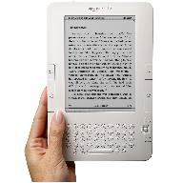
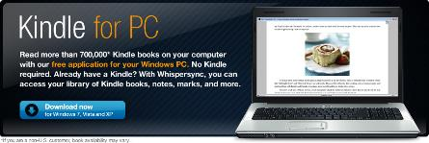
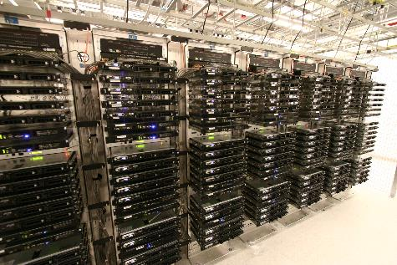

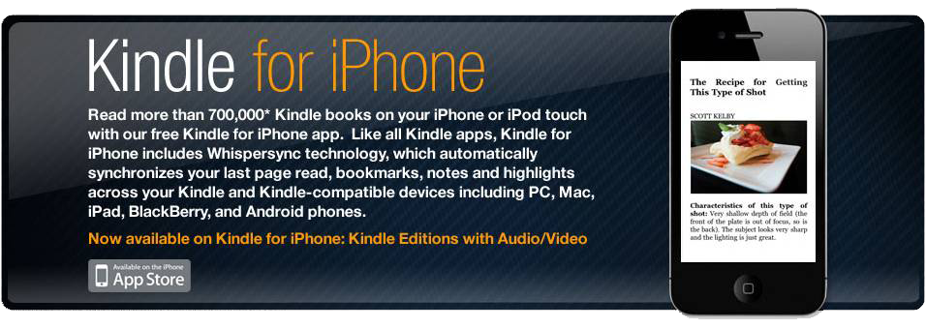
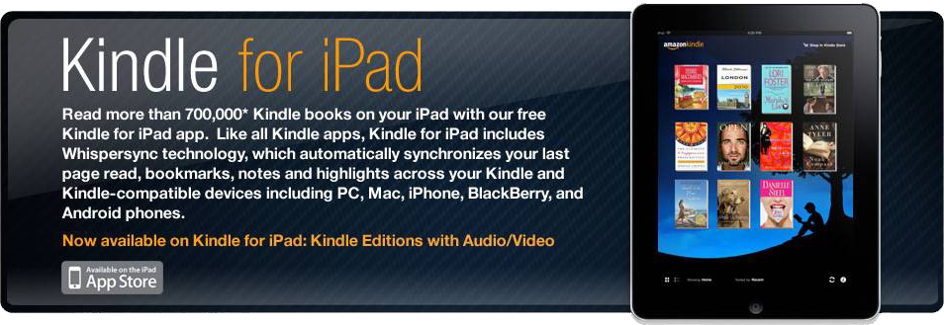
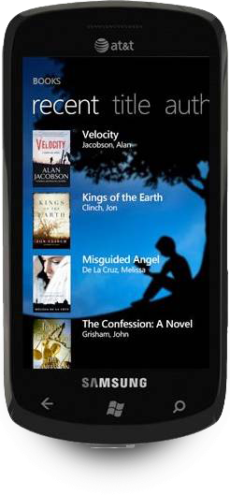
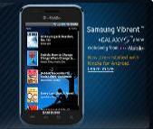
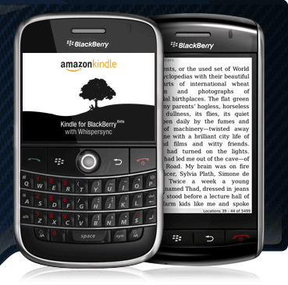
Paradigm shift: from single computer to many mobile devices + (cloud) clusters

Slide 3
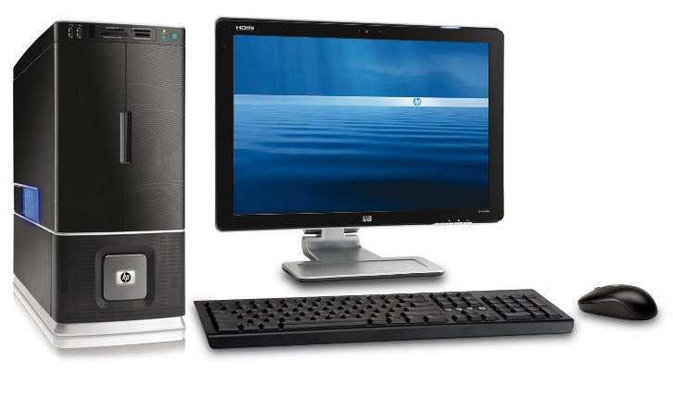
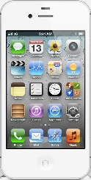
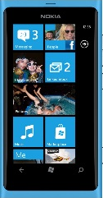
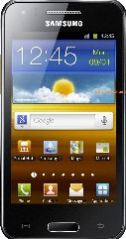
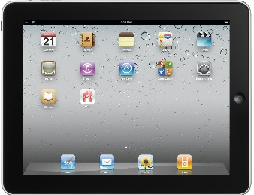
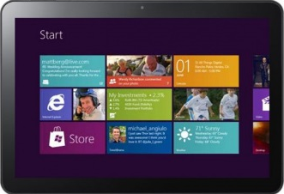
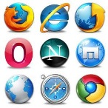
Mobile+cloud app: a distributed system
Multiple users. Code
executes on everything (PC, tablet, phone, service) simultaneously.
How to program this distributed system?
Cloud Service

Slide 4
TouchDevelop is a mobile + cloud app…
a cloud of programmers, scripts, users, data, bugs, …
a browser-based IDE, optimized for mobile devices
a simple statically-typed safe programming language
a set of libraries for sensors, data, services, UI, …
for creating mobile+cloud apps

Slide 5
Cloud

Slide 7
touchdevelop.com

Slide 8
Programming: a social activity, supported by the cloud
Programs move with you
  stored in cloud
  edit/run from any device
Publish programs to cloud, when ready
  versioned, including all required resources and dependencies
  the cloud “never forgets”
Anyone can run/edit a published program
  provenance is tracked
  kudos to original programmer
Collect data associated with programs
  users
  executions
  likes, comments
  crashes, bug reports
  tests
  coverage
  profiles
  …

Slide 9
opportunity: data mining
REST-based service APIs at http://touchdevelop.com/api/...
lists | properties
/api/scripts /api/users /api/comments /api/screenshots /api/reviews /api/tags /api/art ... | /api/[id] /api/[scriptid]/text /api/[scriptid]/ast /api/[scriptid]/successors /api/[scriptid]/base /api/[userid]/scripts /api/[scriptid]/comments /api/[scriptid]/screenshots /api/[scriptid]/reviews /api/[userid]/picture …
touchdevelop.com/help/cloudservices
Notes:
http://www.touchdevelop.com/api/scripts?count=20

Slide 10
Cloud-based software engineering: connecting the dots
Users
Programmers
Language Designers
Notes:
Language designer
What language features are being used?
Impact of breaking changes
Programmer
Updates to users
User feedback
User
XXX

Slide 11
IDE

Slide 13
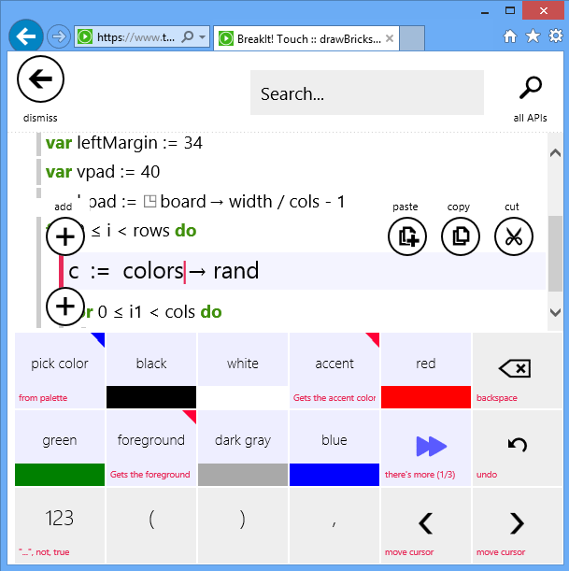
Integrated Development Environment (IDE)
TD language + semi-structured editor
TD: typed, imperative, procedural,
data-structures, module system
Syntax-directed editing of statements
Token-based editing of expressions
IDE implemented in TypeScript (JavaScript)
in-browser compilation of TD to JavaScript

Slide 14
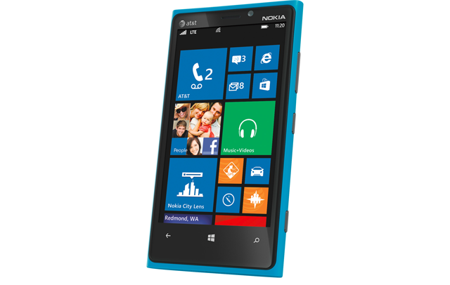
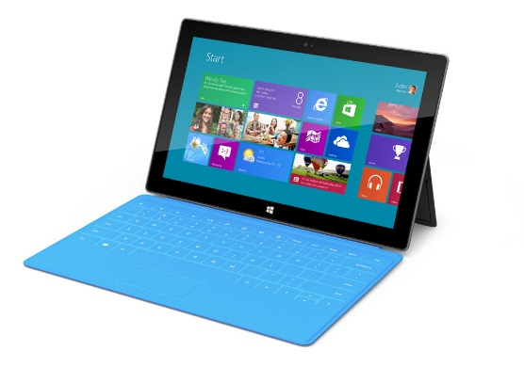
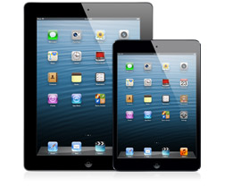
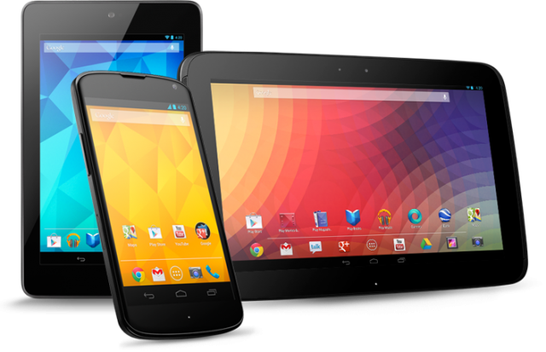
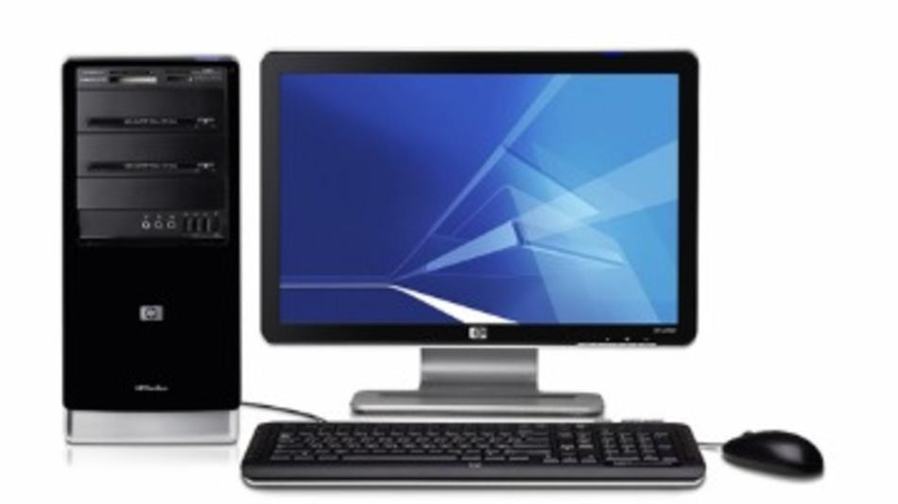
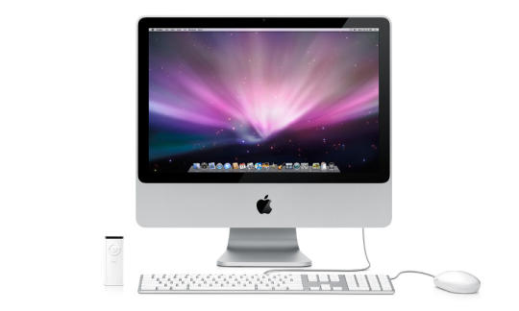
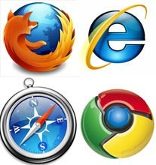
TouchDevelop works cross-platform

Slide 15
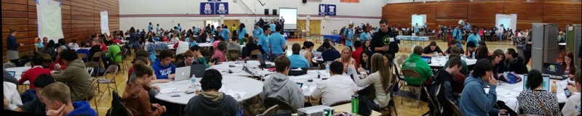
touchdevelop + education
1st App Day in May 2013, 500+ students.
Many follow-up events, and 1500 students planned this year.

Slide 16
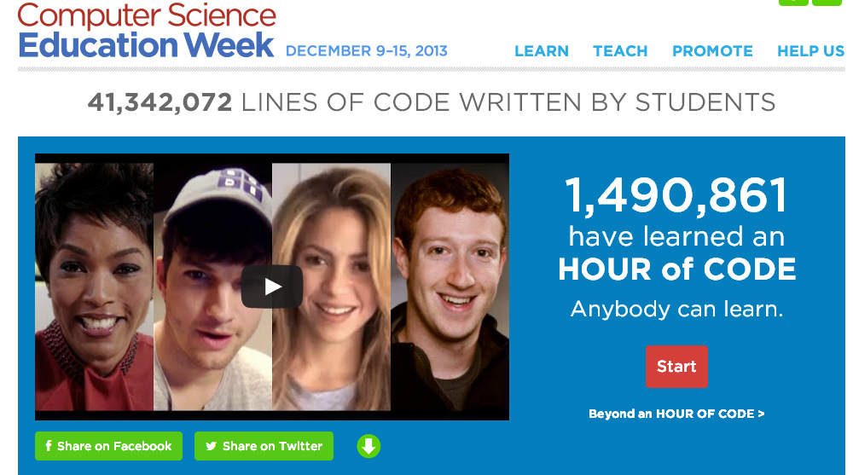
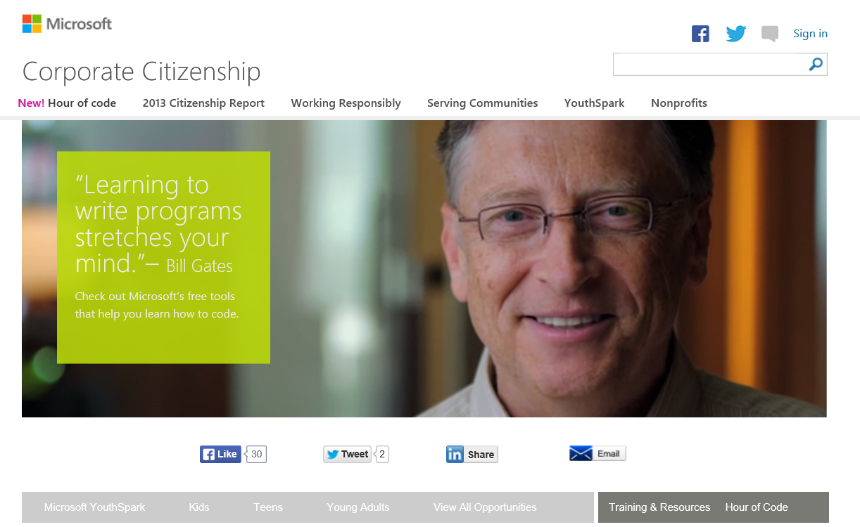
CS Education Week - Hour of Code (Dec 2013)
Helping 10,000,000 students program for the first time.
TouchDevelop is one of Microsoft contributions.
http://csedweek.org/
http://microsoft.com/hourofcode

Slide 17
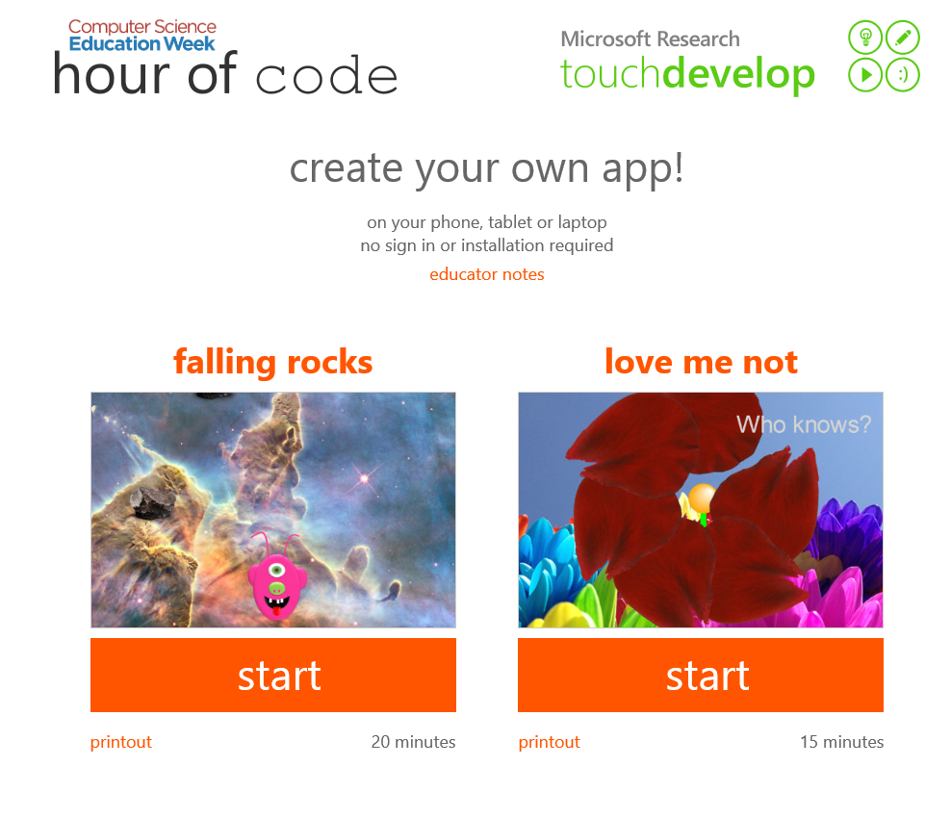
www.touchdevelop.com/hoc

Slide 18
Language

Slide 19
abstract syntax
script ::= meta-info decl*
decl ::= action | page | event | global | library | record
action ::= private? sync? action sig stmt*
event ::= event sig stmt*
page ::= private? page sig init stmt* display stmt*
sig ::= id (id : type)* returns (id : type)*
global ::= var id : type flag*
record ::= cloud? (object | table | index | decorator) keys (id : type)* values (id : type)*
stmt ::= expr | // comment | if expr then stmt* else stmt* | loop do stmt* | boxed stmt*
loop ::= while expr | for id < expr | for each id in expr
expr ::= token* (where sig stmt*)*
token ::= “...” | true | false | 0 | 1 | ... | ( | ) | , | + | * | ... | async | id | → id

Slide 20
Design considerations
Familiar imperative block-structured language
  on the path from Scratch to JavaScript
Touch-friendly syntax and semantics
  static types for intelligent keyboard
High-level of abstraction
  do more with less code

Slide 21
Language abstractions
Boxes
  graphical user interface
  enforces model-view-control pattern
  enables data-driven apps that update in response to changes
Cloud types
  simple abstractions for replicated state
  provides automatic synchronization and merging of updates
  enables social apps with sharing

Slide 23
Language abstractions
Boxes
  graphical user interface
  enforces model-view-control pattern
  enables data-driven apps that update in response to changes
Cloud types
  simple abstractions for replicated state
  provides automatic synchronization and merging of updates
  enables social apps with sharing

Slide 24
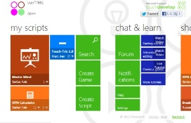
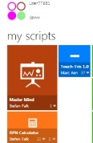

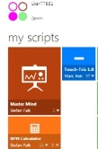


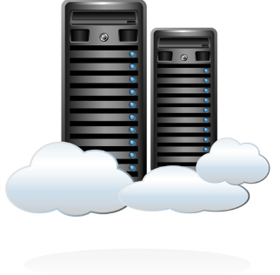
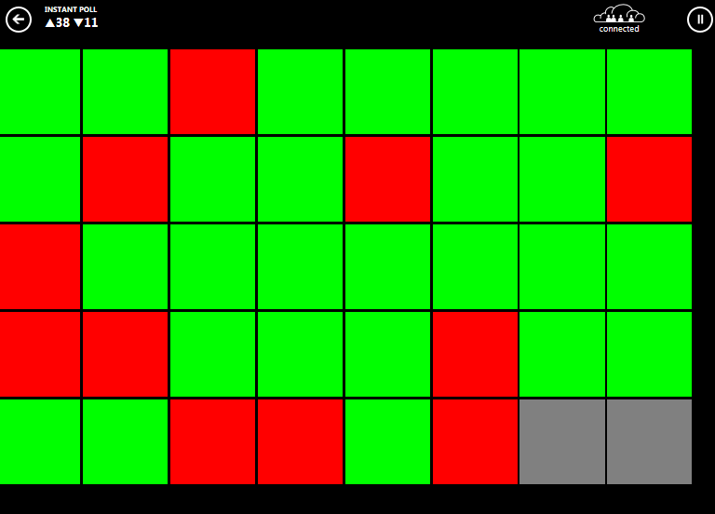
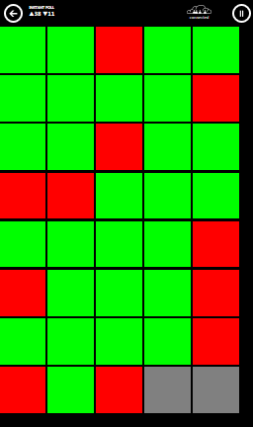
TouchDevelop and cloud types
TouchDevelop is itself a distributed application:
develop on everything (PC,tablet,phone,service) simultaneously
Cloud types let you easily develop distributed applications:
Write apps that run on (PC,tablet,phone,service) simultaneously

Slide 25
Programming a distributed application
Abstraction Level increases, Code Size decreases
Message Passing
(Actors)
Shared State
(Web Apps)
Replicated Shared State
(Cloud types)
Cloud Storage
Cloud Storage
Server
code
Server
Server
Updates
Queries
Sync when connected
code
code
Cloud Service
(stateless)
code
Mobile App
Mobile App
Mobile App
Mobile App
Updates
Queries
Updates
Queries
Read
Write
Read
Write
Mobile App
Mobile App
code
code
code
code
code
code

Slide 26
Cloud types
Pro:
Can read and write all data at all times
responsive, offline support
Hide unreliability of network and server
no failure handling code
Con:
Weak consistency model
may surprise you
Replicated
Shared State
Cloud Storage
Sync when connected
Mobile App
Mobile App
Read
Write
Read
Write

Slide 27
Composable Cloud Types
Primitive cloud types
    Cloud Integer
    { get } { set(x), add(x) }
    Cloud String
    { get } { set(s), test-and-set(s) }
    Cloud XXX
    { get } { set(x) }
Structured cloud types
    Cloud Table
    (cf. entities, tables with implicit primary key)
    Cloud Index
    (cf. arrays, key-value stores, relations)

Slide 29
Libraries

Slide 30
User-defined libraries
Appear just as built-in (in language and IDE)
Underlying types hidden
Extension actions to simulate object-oriented dispatch

Slide 32
The Meta-level Test
Creating X Apps via X, where X = Mobile + Cloud
Program a compiler for language X in language X
Can we program TouchDevelop in TouchDevelop?

Slide 34
touchdevelop.com
Cloud
Language
IDE
Libraries
for mobile+cloud apps

Slide 35
Read more about it
TouchDevelop: programming cloud-connected mobile devices via touchscreen, in Proceedings of the 10th SIGPLAN symposium on New ideas, new paradigms, and reflections on programming and software, 2011
Cloud Types for Eventual Consistency, in Proceedings of the 26th European Conference on Object-Oriented Programming, 2012
User-Aware Privacy Control via ExtendedStatic-Information-Flow Analysis, Proc. 27th IEEE/ACM International Conference on Automated Software Engineering, 2012
Keyword Programming for TouchDevelop, in Proceedings of the 11th international conference on Mobile systems, applications, and services, 2013
It's Alive! Continuous Feedback in UI Programming, in PLDI, ACM SIGPLAN, 2013
A Comprehensive Field Study of End-User Programming on Mobile Devices, in Proc. IEEE Symposium on Visual Languages and Human-Centric Computing, 2013

