Slide 1
Written Technical Communication (Part II)
Klara Nahrstedt

Slide 2
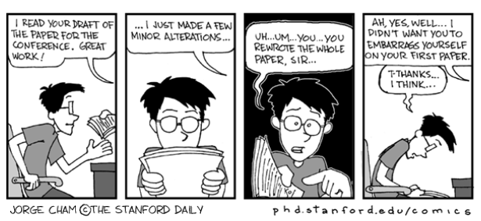
We all start !!!

Slide 3
What we will talk about
Writing Conference/Journal Papers has been extensively covered in KOM (see Abed’s slides “Writing is not an Art” and the many references)
I want to show that “Writing is an Art” and concentrate on
  Style – art of writing and lessons learned from style mistakes
IF TIME PERMITS I will also cover Other Forms of written communication
    Writing CVs and resumes
    Writing large project reports

Slide 4
Study the art of writing
Writing well gives you an “unfair advantage”
Writing well matters in getting your work published in top venues
Highly recommended
  William Strunk Jr. and E.B. White “The Elements of Style” , 4th edition, Longman , 2000
  Justin Sobel, “Writing for Computer Science: The Art of Effective Communication”, 1997
  Joseph M. Williams, “Style: Ten Lessons in Clarity and Grace”, 7th edition, Longman, 2003
Who do you think are the best writers in your area: study their style

Slide 5
10 Principles for Writing Clearly
Distinguish real grammatical rules from folklore
Use subjects to name the characters in your story
Use verbs to name their important actions
Open your sentences with familiar units of information
Begin sentences constituting a passage with consistent topics/subjects

Slide 6
10 Principles for Writing Clearly
Get to the main verb quickly
  Avoid long introductory phrases and clauses
  Avoid long abstract subjects
  Avoid interrupting the subject-verb connection.
Push new, complex units of information to the end of the sentence
Be concise
  Cut meaningless and repeated works and obvious implications
  Push the meaning of phrases into one or two words
  Prefer affirmative sentences to negative ones
Control sprawl
Above all, write to others as you would have others write to you.

Slide 7
Lessons Learned from Style Mistakes
Three “B’s”
Brevity
Balance
Benefit
Using examples from the “wild.”

Slide 8
Brevity
Say it simply

Slide 9
Make the Thesis Obvious
thesis (n): a position or proposition that a person advances and offers to maintain by argument

Slide 10
An introduction with no point
The current media climate surrounding the issue of declining enrollment and lack of diversity in the sciences ought to peak the interest of today’s scientists and educators. Between 2000 and 2005, the NSF reported that interest in computer science as an undergraduate major fell 70%.
In 2005, when women made up of 15% of computer science undergraduates, Harvard president and economist Larry Summers suggested that gender differences in “overall IQ, mathematical ability, scientific ability” kept women out of engineering and science fields.
One year later, Michael Nettles and Catherine Millet reported in their book “Three Magic Letters” that of all surveyed doctoral students in mathematics and engineering, African Americans were more than three times less likely than whites to publish and had lower completion rates than either white students or international students [Nettles and Millett 2006].

Slide 11
An introduction with a thesis
Current practices to resolve the lack of diversity and interest are recruitment and retention, and focus on support groups for underrepresented groups. Support groups are important and provide a valuable service, yet they narrow the community’s focus on only a subset of the population. They do not work towards networking students with teachers and faculty, graduates with undergraduates; relationships that contribute to student success.
Computer science needs to look over a broader horizon to enrich the field with more and diverse participants. We conjecture that attracting new students and retaining current ones are just two approaches to introducing newcomers into the computer science community of practice.

Slide 12
Write Less (Short Sentences)
Before
“With a dependency specification in hand, the tool can readily produce a range of information useful in dependency analysis such as:”
After
“The tool produces the following analyses:”

Slide 13
Avoid Passive Voice
Before
“The components that make up ION's power subsystem are diagrammed in Figure 1.”
After
“Figure 1 summarizes ION's power subsystem.”

Slide 14
Write One Thing at a Time
Before
“Although Figure 2 shows that ION has nine separate applications onboard, only the power application will be discussed in detail due to space limitations and because it is necessary to understand the failure that will be discussed in Section 4.”
(long sentence, passive tense, difficult to understand)
After
“ION has nine applications; we discuss the Power application here so that readers understand the details of the dependency analyses Sections 4.”

Slide 15
Avoid Repetitive Buzzwords
Page 1(abstract)
We preprocess the videos, apply feature extraction, feature matching and a unique parallel line matching algorithm to develop a simple yet a powerful face recognition system.
Page 1
In this paper we target the recognition of faces in news videos in a very simple but a powerful manner using a huge picture database collected by Berg et.al[10].
Page 1
The primary aim of our work is to come up with a name for the face in every frame of the video. We have tried to tackle this problem using a very simple and a powerful approach. We present an appearance based model to recognize faces in news videos.
Page 4
This tells us that doing the parallel line checking is a reasonable approach that helps us to get rid of the false alarms using a very simple and a powerful approach explained earlier.

Slide 16

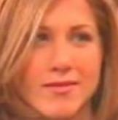
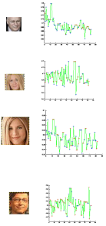
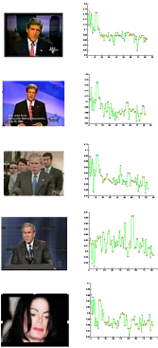

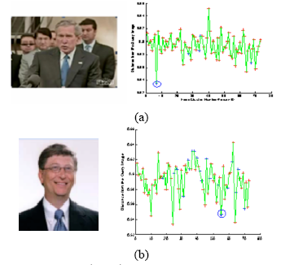
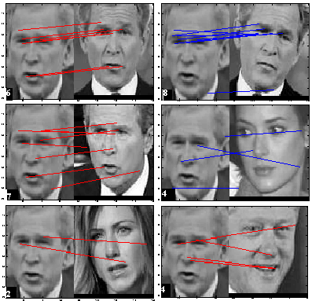
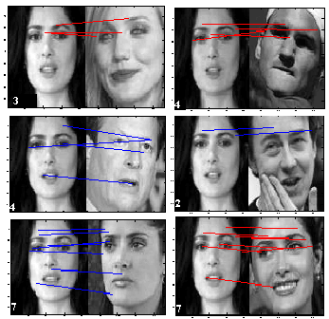
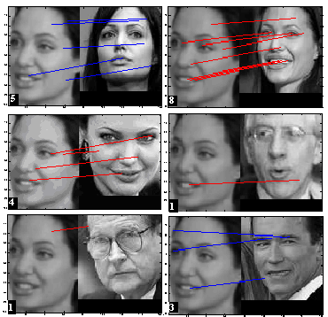
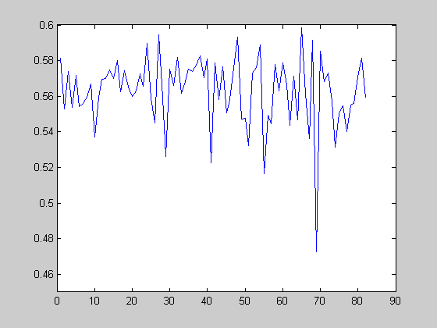
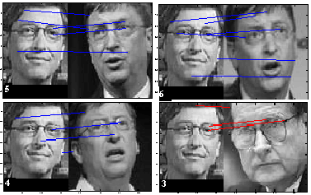
Choose Salient Figures Early
Before
After

Slide 17
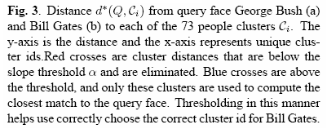
Describe Figures Succintly

Slide 18
Balance
Balance the formal with the informal

Slide 19
Be Formal (no folklore, please)
Before
“Coolnes of out system? As many queries as u want... deals with large number of people73… previous systems show tests on fewer people… We are working on elaborating the system to …bla bla…”
After
“Our system currently recognizes a query face out of 73 different people with a total of 2000 faces, and can be further expanded. The system was tested on numerous videos of low resolution and still images of high resolution from the internet.”

Slide 20
Be Informal (wrong style)
Def
Def
Def

Slide 21
Be Informal (wrong style)
Running out of symbols

Slide 22
Be Informal (correct style)
Intuition
Simple
Example
Simplified
notation

Slide 23
Be Informal (correct style)
Incrementally
more
complicated

Slide 24
Benefit
Write for the benefit of your audience

Slide 25
Motivation (wrong style)
Motivation?
Intuition?
Who needs
those?

Slide 26
Motivation (correct style)
Motivation/
Who needs it
Intuition

Slide 27
Assumptions (wrong style)
Dive directly to algorithms, data explanations
  “We present algorithms for Filtering in permuting domains”...
Use only mathematical symbols for assumptions
  s ~~> t

Slide 28
Assumptions (correct style)
“Let us consider the XY data model stored in Z representation. We present algorithms for Filtering in permuting domains”...
Let us assume a stream of data items ‘s’ and its aggregated value ‘s~~’. Let us assume that the aggregated value ‘s~~ has a lower bound ‘t’, i.e., s ~~> t

Slide 29
Good writing takes times
Give yourself time to reflect, write, review, refine
Give others a chance to read/review and provide feedback
  Get a reader’s point of view
  Find a good writer/editor to critique your writing
Starting a paper three days before the deadline, while results are still being generated, is a non-starter !!!

Slide 30
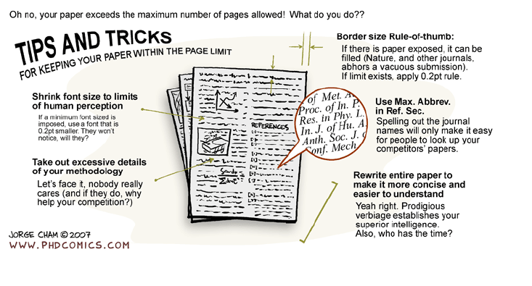
Summary

Slide 31
References
Abed Saddik’s slides from 2008 “Writing is not an Art”
Anne Eisenberg “Effective Technical Communication”, 2nd edition McGraw-Hill, Inc. 1992
Bell, Arthur H. Tools for Technical and Professional Communication, NTC Publishing Group, Lincolnwood, 1995
Eisenberg, Anne A.: Beginners Guide to Technical Communication, WBC McGraw-Hill, Boston, 1998.
Hicks, T.G. & C. M. Valorie: Handbook of Effective Technical Communication, McGraw-Hill, Boston, 1989.
Huckin, T. N. and L.A. Olson: Technical writing and Professional Communication for Nonnative Speakers of English, McGraw-Hill, NY, 1991.
Little, Peter: Oral and Written Communication, Longman, London, 1979.

Slide 32
References
William Strunk Jr. and E.B. White “The Elements of Style” , 4th edition, Longman , 2000
Justin Sobel, “Writing for Computer Science: The Art of Effective Communication”, 1997
Joseph M. Williams, “Style: Ten Lessons in Clarity and Grace”, 7th edition, Longman, 2003
Mary Shaw, “Writing Good Software Engineering Research Papers”, IEEE 25th ICSE, 2003
Roy Levin and David D. Redell, “How (and How Not) to Write a Good System Paper”, ACM SIGOPS Operating Systems Review, Vol. 17, No. 3, July 1983, pp. 35-40
http://conferences.sigcomm.org/co-next/2006/files/pres/10tipsforwritingapaper.pdf
CS 598lrs, Instructor: Lui Sha, Spring 2007, Computer Science Department, University of Illinois at Urbana-Champaign

Slide 33
References
http://www.xecutivesearch.com/
http://www.ivillage.co.uk/workcareer/findjob
http://www.cv.ee
Oxford University Careers Service
T. Kulsehariduskeskus, “CV-writing”, Action Programme of the EU, Project No. 2002 LA 112 628 BILVOC
http://www.bestresumewriting.com/writing-a-good-resume.html

Slide 34
IF TIME PERMITS – OTHER FORMS OF WRITTEN COMMUNICATION
RESUME, CV, LARGE PROJECT REPORTS

Slide 35
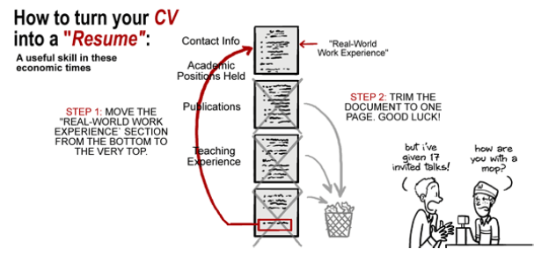
Resumes and CVs

Slide 36
Resume (Companies)
Creating the Right Header
Kicking of Your Resume
  Summarize Qualifications
  Avoid resume cliches that put the employer to sleep
  Facilitate a smooth career change with effective phrases
Creating a mini-resume with your Heading, Job Objective, and Summary of Qualifications
  Show Your Good Past
  Creating a work history that shows off your strengths.
  Disguising gaps in your employment history.
  Adding volunteer experience to your Work History section.
  Making your promotions noticeable at a glance.

Slide 37
Resume
Show Your Achievements
Your Education and Credits
  What not to put on your resume
Final Things and Delivery
  Making sure your resume is in order
  Looking spiffy on paper
  Using the right type
  Getting your resume to the employer

Slide 38
CV (Curriculum Vitea) - Academia
Personal information
Education, qualifications, skills
Career history, career summary
Achievements, additional information
  Talks
  Publications (books, journals, conferences, workshops, posters, news-articles, blogs, reviews)
  Proposals/Grants
  Students you supervised/graduated
  Classes you taught
  Professional Services (TPC, editorial boards, review panels, advisory boards, ….)

Slide 39
Make sure your CV
Does justice to your skills, abilities and qualifications
Is easy to follow
Clearly shows you meet the requirements of the job
Uses language you're comfortable with when talking about yourself
Shows you have researched the employer thoroughly.

Slide 40

Consider
Don’t overwrite your CV
Check the layout (plenty of white space)
Use short sentences
Give only the information that is relevant to the employer
First impressions matter!
Check the CV for spelling and grammar mistakes
Always print out your CV (unless required otherwise)

Slide 41
Writing Process of Large Projects
The CORE Method (Composing organically for reader engagement) by Jimmie Killingsworth
Writing should begin before the research begins.
Define the questions your research seeks to answer (the following questions are derived from the Mary Shaw article you read).
  What specific questions does your research seek to answer?
  Why are these questions important?
  Is there a connection between this question larger questions or issues?
  Who will be the audience for your research
Write a core document
  One to two page limit
  Answers questions from step one

Slide 42
Writing Process of Large Projects
3. Do the research project
4. Write second core document
5. Develop graphics
  Support main points with graphics
  Cover as much material as possible in graphic form
  Adapt graphics for use in an oral presentation
6. Give oral briefing
7. Write full draft
8. Edit
9. Deliver

