Slide 1
AVL ALGORITHM VISUALIZATION LANGUAGE
Aditya Pipersenia (Project Manager)
Deepak Sebastian (Language Guru)
Krishnan Rajeswar (System Integrator)
Raymond Barker (System Architect)
Rohit Ramesh (Test & Verification)

Slide 2
OUTLINE
Why AVL ?
AVL – Programming Language
Language Features
System Architecture
GUI – AVL in Action
Testing
Conclusions

Slide 3
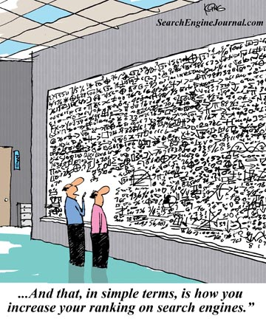
Why AVL ?
Learning Algorithms – HARD !
Difficult to Visualize !
Solution?

Slide 4
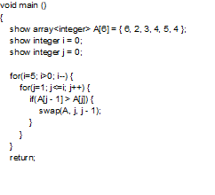
AVL – Programming Language

Slide 5
Language Features
Easy To Learn Syntax – C Programming Language
Visual Output
Control over the speed of Animation
Line by Line Execution Displayed

Slide 6
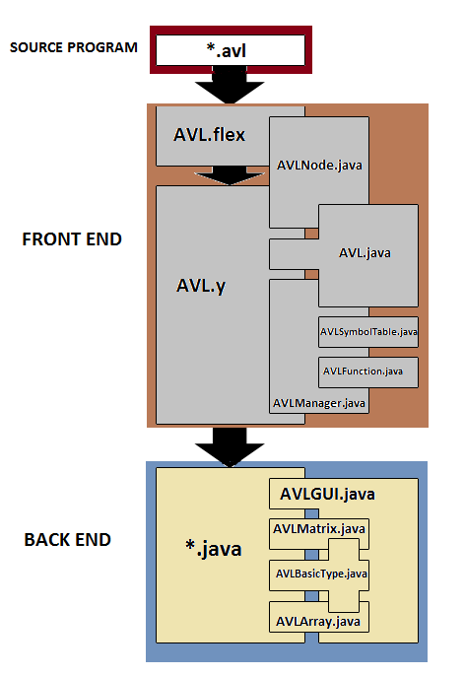
System Architecture

Slide 7
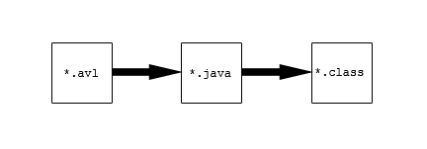
Compilation

Slide 8
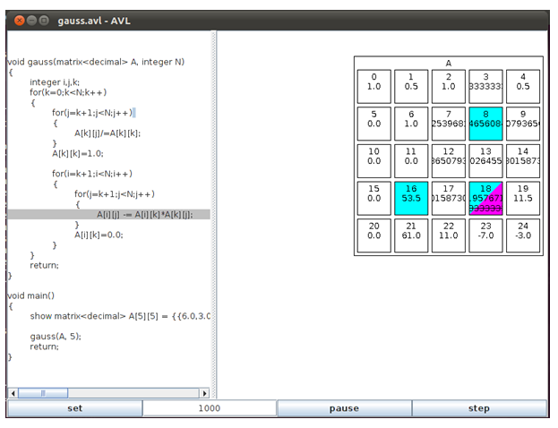
GUI – AVL IN ACTION

Slide 9
Development Tools

Slide 10
Test Strategy
Test suites written to check for corner cases.
Unit Testing by each team member
Semantic Testing
Functional Testing on grammar and GUI
Integration Testing

Slide 11
Conclusions
Lessons Learned
Implementation specifics should be discussed during design phase
Implementing C like grammar very difficult
Team management skills

Slide 12
Future Work
Extend to support Data Structures like Binary Trees, Heaps, Linked List etc.
Add Functionality more to GUI

