Slide 1
Day-Trader A language for day trading
COMS 4115 Programming Language and Translator
Tsung-Kai Lin(tl2450)
Jie Huang(jh3105)
Fang Da(fd2263)
Ran Wang(rw2409)
Shao-Chuan Wang(sw2644)

Slide 2
Outline
Introduction (Tsung-Kai)
Language Feature (Jie)
System Architecture (Fang)
Implementation and Integration (Ran)
Test Plan (Shao-chuan)
Demo

Slide 3
Outline
Introduction (Tsung-Kai)
Language Feature (Jie)
System Architecture (Fang)
Implementation and Integration (Ran)
Test Plan (Shao-chuan)
Demo

Slide 4
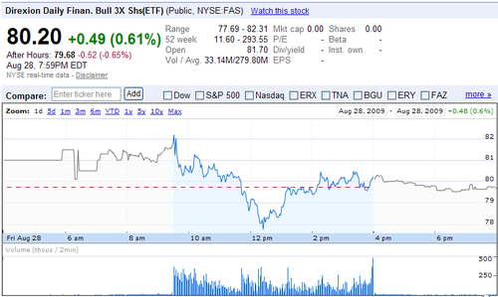
Day Trading
Buying and Selling within one day
High frequency and short term trading

Slide 5
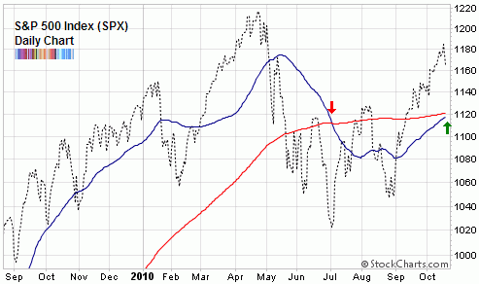
Predict the Trend
Indicators can help predict the trend of stocks
Apply strategy to make money

Slide 6
Searching For Potential
Stock Market
Portfolio
Indicator
Indicator
Subset
Subset
Indicator
Indicator
Potential Stock
Potential Stock
Buy
Sell
Action

Slide 7
Outline
Introduction (Tsung-Kai)
Language Feature (Jie)
System Architecture (Fang)
Implementation and Integration (Ran)
Test Plan (Shao-chuan)
Demo

Slide 8
Simple
Trend Following
Notes:
The most significant character of our language is it is very simple. Here is an example program written in daytrader.
The second line ‘rise greater than 8%’ is to find all the stocks which currently have a rise greater than 8%, then if any stock meeting this condition is found, buy 100 unit of each of them.
The comments following each line shows the set of stocks passed to each line, which is the filtering result of the previous line, for example...
The Boolean value will be set to false only if the set of stocks becomes empty
This simple program actually implemented a trading technique frequently used in real practice – trend following.

Slide 9
Efficient
@BUY
MA1(10) crossup MA1(15)
select “MSFT”, “GOOG”, “DELL”
Notes:
The next objective we want to achieve is to make our program very efficient,
The first line of the program is to find all the stocks from the stock market with 10 days’ moving average crossup its 15 days moving average. It is a very expensive operation because it has to look up a lot of history data
But if...
With this observation, we decided to do some optimization on our syntax tree to reorder the sequence of the program lines

Slide 10
> (0)
3 + 2 = 5
Math.round(2)
1 + 2 = 3
volume (1)
1
Property.getd(2)
0 + 0 + 2 = 2
“MSFT” (0)
0
“volume” (0)
0
Notes:
In order to do the reordering, we need to solve two problems, one is when we can do the reordering, second is how we can do it. Look at this sample program.
To answer the first question, when we can do the reordering, our principle is, whenever the reordering will not change the program output, then we can do it. So here in this example. Only print and buy can not participate in the reordering. Then we have two groups of lines in which reordering can be done.
Then how we can do the reordering in each group? We want to put the line running fastest to the top and the line running slowest to the bottom.

Slide 11
Efficient

Slide 12
Outline
Introduction (Tsung-Kai)
Language Feature (Jie)
System Architecture (Fang)
Implementation and Integration (Ran)
Test Plan (Shao-chuan)
Demo

Slide 13
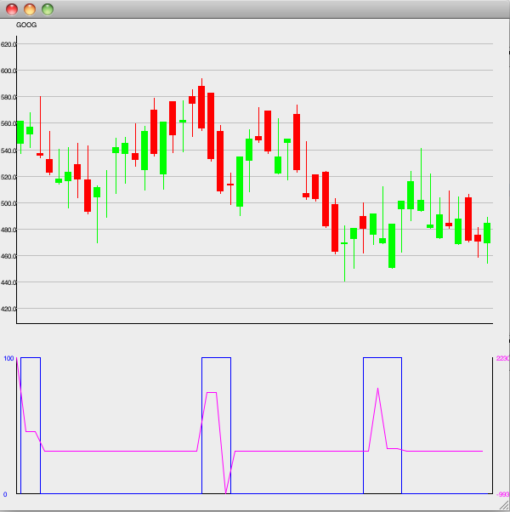
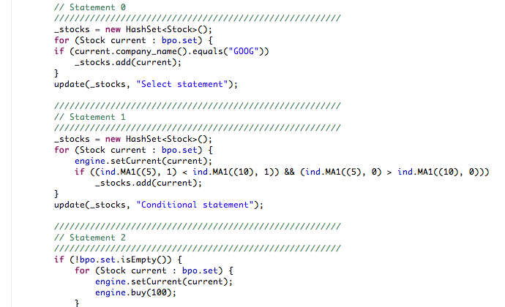
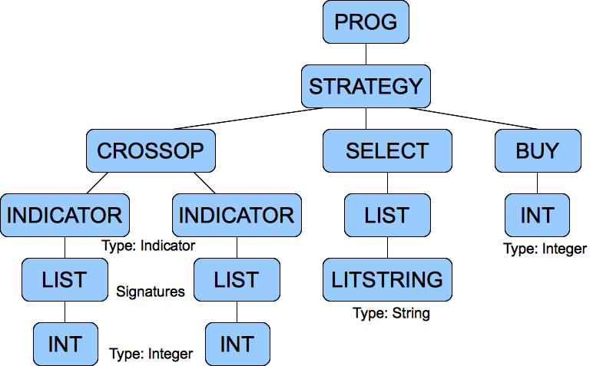
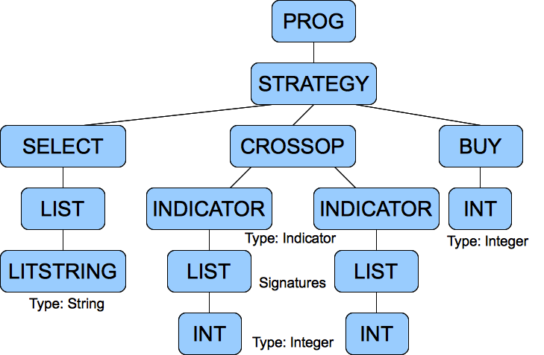
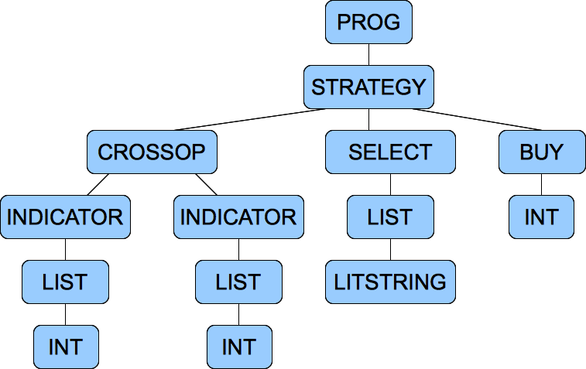
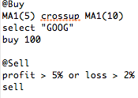
Architecture
Source
Lexer
Lexeme Stream
Parser
Syntax Tree
Semantic Anal.
Annotated Synt. Tree
Code Optimizer
Code Generator
GUI
Engine
Strategy
Data Source
Run-time
Library
Java Compiler
Executable

Slide 14
Outline
Introduction (Tsung-Kai)
Language Feature (Jie)
System Architecture (Fang)
Implementation and Integration (Ran)
Test Plan (Shao-chuan)
Demo

Slide 15
Software Development Environment
Simulation System
Stock market simulation
Trading system simulation
Distributed Development
Google Code repository
Bug Tracking
Bug list
Sample bug
Meeting Log
Feature maintenance

Slide 16
Implementation
OS Platform
Languages and IDE
Eclipse
Multi-level Makefiles
SVN
External Libraries
JFLEX
BYACC

Slide 17
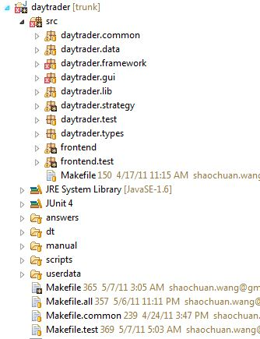
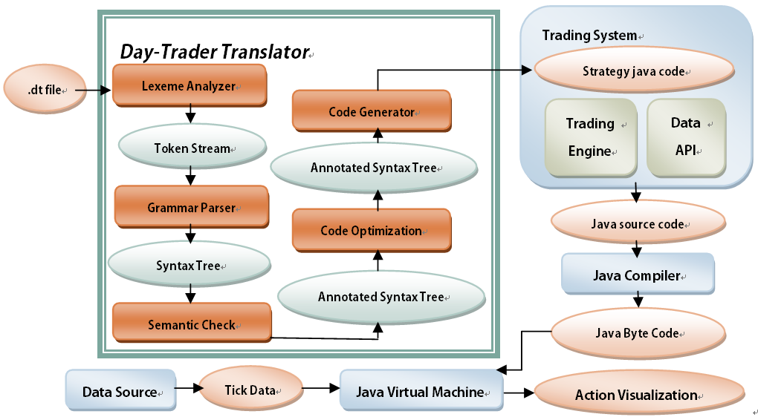
System Integration
Integration within the translator
Integration across entire system

Slide 18
Outline
Introduction (Tsung-Kai)
Language Feature (Jie)
System Architecture (Fang)
Implementation and Integration (Ran)
Test Plan (Shao-chuan)
Demo

Slide 19
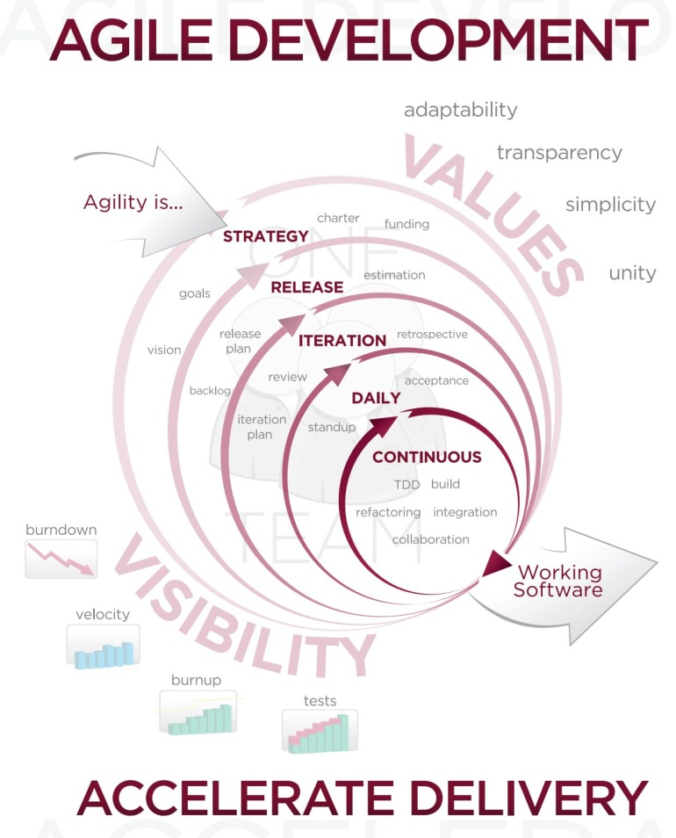
Test Plan: Agile Testing
Focus on working software
Test script before commit the code
Responding to changes
Pair/triple programming weekly
Hierarchical test framework:
Unit test/Regression test
System test
Tools:
Junit/Makefile script/Bash script

Slide 20
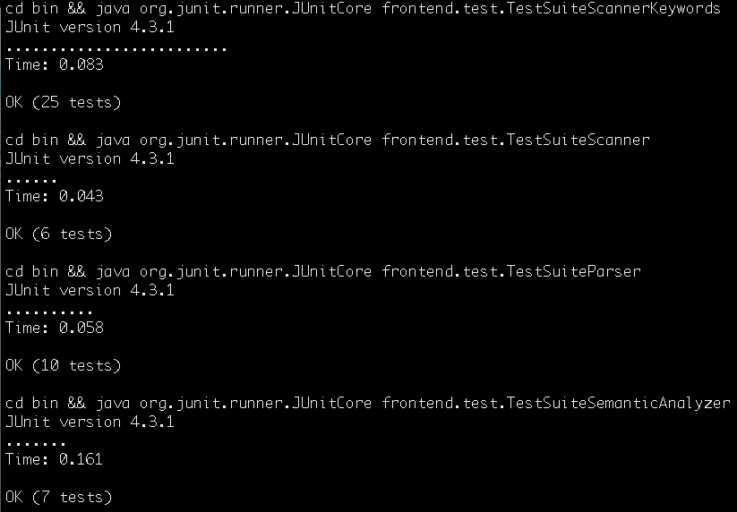
Unit tests/Regression Test
Screenshot

Slide 21
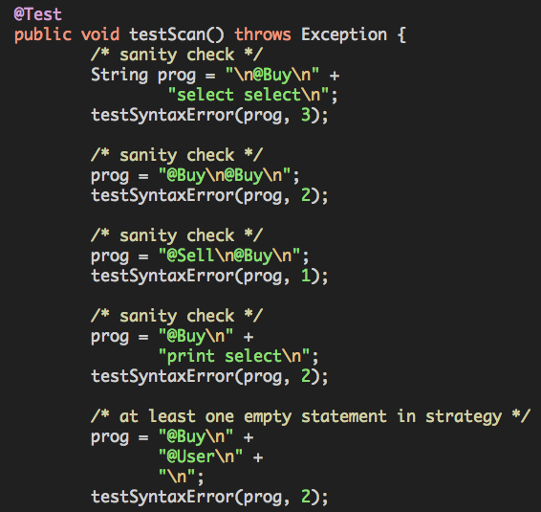
Snapshots on test case (1/2)
ParserSyntaxErrorTest.java
Check if the syntax errors are issued correctly
Also check the line number.

Slide 22
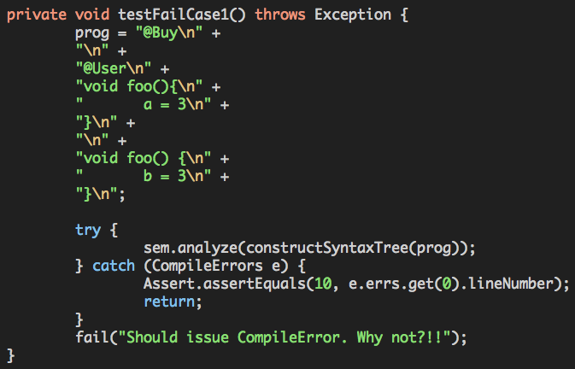
Snapshots on test case (2/2)
TypeCheckNameConflictionTest.java
Multiple definitions of the same function names

Slide 23
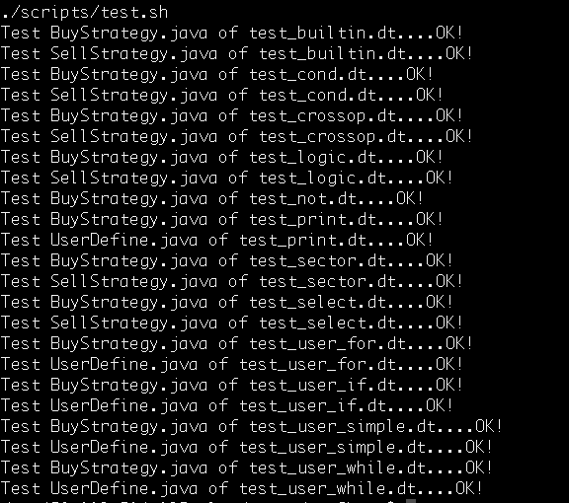
System Test Screenshot
Generate the compiled java sources codes.
Diff with the “answers”.

Slide 24
Outline
Introduction (Tsung-Kai)
Language Feature (Jie)
System Architecture (Fang)
Implementation and Integration (Ran)
Test Plan (Shao-chuan)
Demo

Slide 25
Thanks!
Q & A

