Slide 1
Team 2: Flow A Graph Language
David Hughes
Mark Liu
William Liu
Moses Nakamura
Stephanie Ng

Slide 2
An Introduction to Flow
Mark Liu, Language Guru

Slide 3
The Beginning
Initial idea
Language to create and solve min-cost flow graphs

Slide 4
The Min-Cost Flow Problem
A network of nodes are connected by arcs.
Each node demands a certain number of units of a good.
Each arc defines a cost of shipping units between nodes.
Which paths should we use to ship goods to satisfy all demand and minimize cost?

Slide 5
Generalize the Problem
Our language should be able to do two things:
Declare a graph (Grapher)
Compute a result about the graph (Solver)

Slide 6
Flexibility
A user defines a Graph using the Grapher language
Another user defines an algorithm to solve a general class of graph problems using the Solver language

Slide 7
Usefulness
Specify graphs without knowing what they look like a priori
One solver can be used on multiple different graphs

Slide 8
Flow File Structure
David Hughes, System Integrator

Slide 9
The Typedef File
The typedef is a “handshake”.
The typedef is an agreement between the Graph and Solver files about the structure of each Node and Arc, and which Nodes will be labeled.

Slide 10
Invoking the Compiler
Flow.java is the Compiler driver.
Flow.java looks at the Solver and Graph files, determines their file type, and invokes the appropriate parser.
The Solver and Graph parsers invoke the typedef parser.
The Graph and Solver are converted to Java files.

Slide 11
Structure of the Output
Node and Arc construction takes place in the constructor of the Graph file.
Label Nodes have accessors in Graph.java.
All code outside of function definitions appears in the main method of Solver.java.
Function definitions appear as static methods.
The first line of Solver.java instantiates a Graph object.

Slide 12
Program Walkthrough
Stephanie Ng, Project Manager

Slide 13
Sample Program
DFA simulation
Language: all string’s of a’s and b’s with an even number of both a’s and b’s

Slide 14
Typedef: Even.flowt
//Each state node has two attributes
Node state(string value, int isAccepting) START; //START is a required node label
//Each path arc has one attribute
Arc path(string symbol);

Slide 15
Graph definition: Even.flowg
//Specify the typedef
use 'Even.flowt';
//Building the graph
START: @s0 "s0", 1; //state s0 is labeled as the START state
@s1 "s1", 0;
@s2 "s2", 0;
@s3 "s3", 0;
//Path definition
s0 -> s1 "a";
s1 -> s0 "a";
s1 -> s2 "b";
s2 -> s1 "b";
s2 -> s3 "a";
s3 -> s2 "a";
s3 -> s0 "b";
s0 -> s3 "b";
START
a
s0
s1
a
b
b
b
b
s3
a
s2
a

Slide 16
Solver: Even.flow
List of string input = ["a","a","b","a","b","b","a","a","b"];
int truth = 0;
if (simulate(input)) {
truth = 1;
print "Input is accepted.\n";
}
if (truth == 0) {
print "Input is not accepted.\n";
}

Slide 17
Solver.flow (cont.)
int simulate(List of string input) {
Node current = Graph.START;
int i = 0;
while(i < input.length) {
List of Arc pathLst;
pathLst = current.arcsOut;
Arc next = pathLst[0];

Slide 18
Solver.flow (cont.)
int j = 0;
while(j < pathLst.length) {
Arc connected = pathLst[j];
if(connected.symbol == input[i]) {
next = connected;
print "Went to the next edge.";
}
j = j+1;
}

Slide 19
Solver.flow (cont.)
int isNext = 0;
if (next) {
isNext = 1;
print "Navigating to the node at the end of that edge.";
current = next.to;
}
if (isNext == 0) {
print "There was a problem. Now exiting.";
return 0;
}
i = i + 1;
}

Slide 20
Solver.flow (cont.)
if (current.isAccepting) {
return 1;
}
return 0;

Slide 21
Compilation and Development Process
William Liu, System Tester

Slide 22
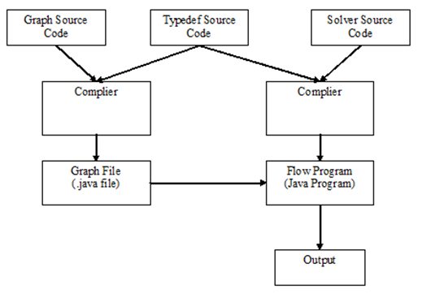
Compilation Organization
Unified compiler
Separate compilation for each file type
Compiled into a Java executable
Notes:
Talk about how flow is compiled

Slide 23
Development Environment
Version control: Git
Change management
Objective based branches

Slide 24
The Flow Abstract Syntax Tree
Moses Nakamura, System Architect

Slide 25
Grapher vs Solver
The grapher and the solver had different grammars
Lesson learned: if you need to duplicate code, find some way of getting around it.
Better way: parser generator

Slide 26
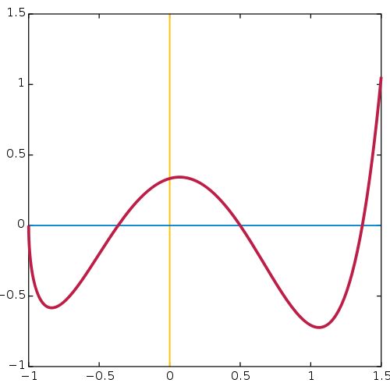
Functions
Functions cannot contain other functions in java, so we had to have special function statement lists
Functions have other weird properties, like return statements . . .

Slide 27
Return Statements
Functions must have a correct return statement, so ensuring that we have a correct return statement and that it is properly typed is critical
Solution: do them simultaneously!
Step 1: check that the list and the new element have the same type.
Step 2: if one or both types is null
Step 3: list is null
Step 4: If they have different types and neither is null, reject!
Step 5: final checking

Slide 28
Code Generation
Moses Nakamura, System Architect

Slide 29
Grapher vs Solver, Round 2
Actually, we managed to use all of the same code generation for graphing and solving!

Slide 30
Reflection
We had to use reflection in the AST, but also in the code generation
Truthy vs falsey
Integers instead of booleans
e.g. enables if (arc) instead of if(arc != null)

