Slide 1
CardGhost ——Language design for card game
Team member:
Yang Jian, yj2220 Xiaoming Guo, gx2158 Yu An, ya2249 Dingding Xi, dx2131
Feng Zhou, fz2168
Notes:
Hello, everybody! I am very glad to make presentation here to you about our Programming language& translators project. We are team 4. First, let me introduce all of our team members: Yang Jian is our project manager, Xiaoming Guo is language guru, Yu An is our System integrator, Dingding Xi is the person who is responsible for language test. I am system architect.

Slide 2
Overview (System Archtitect:Feng Zhou)
Overview (System Archtitect:Feng Zhou)
Outline of Compiler Frontier(Language Guru: Xiaoming Guo)
Back end and Interphase details(System Integrator: Yu An)
Language Test(Tester and validator: Dingding Xi)
Conclusion & Demo(Project Manager: Yang Jian)
Notes:
First, let me introduce to you the overview of our language and compiler.

Slide 3
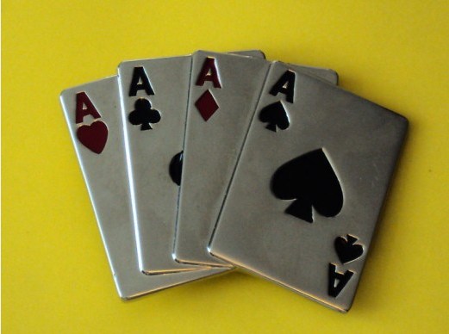
Overview (System Archtitect:Feng Zhou)
CardGhost is a language to design card games
Notes:
Our language is called cardghost. It is a language aimed at helping programmers easily and efficiently design card games. To get a knowledge of how it works, let me intronduce the sturcture of our compiler first.

Slide 4
Struture of our Compiler:
source code is scanned by lexical analyzer and return certain tokens as well as its value(if token have value) to parser.
Parser print out corresponding java code to CardGhost.java
Java functions are called in CardGhost.java to implement certain operations.
Notes:
We use java lex and java cup to generate our lexical analyzer and syntax analyzer

Slide 5
Features of CardGhost
Simple——using cardghost, you can program easily without a lot of training
Flexible——Programmer can define different rules and standard to win
Robust——We design a strongly type language and add error reporter so that our language would be more robust
User-friendly——language is very simple for programmers to understand, provide interphase in language lib so that user can design a card game more easily
Notes:
After learning structure of our compiler, let’s talk about the features of our language.

Slide 6
Development environment
Jian yang: ——Windows XP ——Notepad++ ——JLex & Java Cup
Guo Xiaoming: ——Windows XP ——Notepad++ ——JLex & Java Cup
Xi Dingding: ——Mac OS X ——TextWrangler ——JLex & Java Cup & Java jdk1.6
An yu: ——Mac OS X ——TextWrangler ——Eclipse
Zhou Feng: ——Windows 7 & ubuntu ——Notepad++ ——Easy Eclipse & Java jdk1.5
Notes:
Finally, I want to talk about development environment we use. For a large project, compatibility and version control is very important. So in the beginning, we have a meeting about it and use some tools such as SVN as well as google doc to solve the compatibility problem

Slide 7
Language specific keywords
Data Type:
Player: |name, cards|
Card: |number, suit|
Player[], Card[]
Player p1;
Card[], acard;
......
p1 = |"Bella", acard|;
Built-in Function:
shuffle, defaultpile, defaultprior, ...

Slide 8
Language Grammar
Action code: translate into a java statement
Use a Node class to preserve information for each nonterminal:result(java statement), type(type)
Type filed of a variale node is null. Each time a variable is declared, it's inserted into the symbole table

Slide 9
Language Grammar
expr ::=
expr:e1 ADD expr:e2
{:
if(!((e1.type).equals("int"))) //type checking
{
System.out.println("error:"+e1.type+"!= int");
System.exit(0);
}
if(!((e2.type).equals("int")))
{
System.out.println("error"+e2.type+"!= int");
System.exit(0);
}
else
{
String result = e1.result+"+"+e2.result;
Node a = new Node(result, "int");
RESULT = a; //result assignment
}
:}
|
......

Slide 10
Language Grammar
display_expr::=
DISPLAY LPAR var:v RPAR
{:
if(parser.hash.get(v.result) == null)
{
System.out.println("error: " + v.result + "has not been declared!!!\n");
System.exit(0);
}
else if(!parser.hash.get(v.result).equals("String") && !parser.hash.get(v.result).equals("Player") && !parser.hash.get(v.result).equals("Card")) //type checking
{
System.out.println("error: " + parser.hash.get(v.result) + " is not String/Player/Card");
System.exit(0);
}
else
{
String result = "p.g.display(" + v.result +")";
Node a = new Node(result, "void");
RESULT = a; //result assignment
}
:}
|
......

Slide 11
Language Grammar
func_def::=
type:t var:n1 LPAR formal_list:fl RPAR block:b END var:n2 SEMI
{:
if((n1.result).equals(n2.result)) //error checking
{
String result = "public "+t.type+ " "+n1.result+"("+fl.result+")\n{\n"+b.result + "\n}\n";;
Node a = new Node(result);
parser.hash.put(n1.result, t.type); //insert variable into symbol table
RESULT = a; //result assignment
}
else
{
System.out.println("error_154: function name is not matched.");
System.exit(0);
}
:}
|
...

Slide 12
Language Grammar
proc_expr::= //function call
var:v LPAR expr_list:el RPAR
{:
if(parser.hash.get(v.result)==null) //error checking
{
System.out.println("error: function "+ v.result +" has not been defined!!\n");
System.exit(0);
}
else
{
String result = "p."+v.result + "( " + el.result + ")";
String type = parser.hash.get(v.result);
Node a = new Node(result, type);
RESULT = a; //result assignment
}
:}
|
...

Slide 13
Declaration
Sample Code:
Game
Card [] acard;
Card c1;
int i;
c1 =[|5,Diamonds|,|8, Spades|,|9,Clubs|];
i=0;
while(i<acard.length)
card c1;
C1= acard[i];
display (c1);
i++;
end while;
end Game;
var_decl ::=
type:t var_list:vl SEMI
var_list ::=
var:v
|
var:v COMMA var_list:vl
|
;
Note: 1. Declaration need to be put before any other statement in each block.
2. Can declare a list of variable, Like: int a,b,c;
3. For every declaration, put the variable into symbol table.

Slide 14
Assignment
Sample Code:
Game
Card [] acard;
Card c1;
int i;
c1 =[|5,Diamonds|,|8, Spades|,|9,Clubs|];
i=0;
while(i<acard.length)
card c1;
c1=acard[i];
display (c1);
i++;
end while;
end Game;
assign ::=
var:v ASSIGN expr:e
| card_assign
|player_assign
|array_assign
;
card_assign ::=
var ASSIGN card
;
player_assign ::=
var ASSIGN player
;
array_assign ::=
var ASSIGN LPAR_SQ var_list RPAR_SQ
|card_array_assign
|player_array_assign
;
card_array_assign ::=
var ASSIGN LPAR_SQ card_list RPAR_SQ
;
player_array_assign ::=
var ASSIGN LPAR_SQ player_list RPAR_SQ;

Slide 15
Assignment
Sample Code:
Game
Card [] acard;
Card c1;
int i;
c1 =[|5,Diamonds|,|8, Spades|,|9,Clubs|];
i=0;
while(i<acard.length)
card c1;
c1=acard[i];
display (c1);
i++;
end while;
end Game;
Type check:
1.For variable, check symbol table to get its type and check if right hand and left hand type are equal.
2.For other non terminal symbol: Create node for every symbol which have a attribute of type.

Slide 16
Condition and Loop stat
Game
Player p1,p2;
Card c1,c2;
p1=|"Anyu"|;
p2=|"Guo xiaoming"|;
defaultpile;
Defaultprior;
shuffle;
distribute (p1, 15);
distribute (p2, 15);
while(~( (p1.cards.length==0)||(p2.cards.length==0))) initRound;
c1 = intend (p1);
c2 = intend (p2);
if(c1 < c2) remove(c2);
else remove(c1);
end if;
end while;
end Game;
cond_stat ::= IF LPAR expr RPAR block END IF
| IF LPAR expr RPAR block ELSE block END IF

Slide 17
Condition and Loop stat
Game
Player p1,p2;
Card c1,c2;
p1=|"Anyu"|;
p2=|"Guo xiaoming"|;
defaultpile;
Defaultprior;
shuffle;
distribute (p1, 15);
distribute (p2, 15);
while(~( (p1.cards.length==0)||(p2.cards.length==0))) initRound;
c1 = intend (p1);
c2 = intend (p2);
if(c1 < c2) remove(c2);
else remove(c1);
end if;
end while;
end Game;
loop_stat ::= WHILE LPAR expr RPAR block END WHILE
|FOR LPAR expr SEMI expr SEMI expr RPAR block END FOR

Slide 18
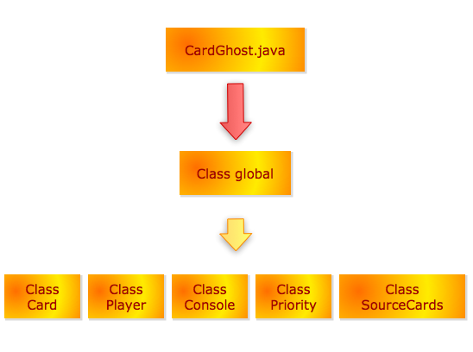
Java END LIBRARY

Slide 19
Game
!a sample game!
Player p1,p2;
Card c1,c2;
p1=|"Anyu"|; p1 = new Player(); p.g.setPlayer(p1,"Anyu");
p2=|"Guo xiaoming"|;
defaultpile; p.g.defaultPile();
hasJoker; p.g.hasJoker();
suitPriority: Diamonds>Spades>Clubs>Hearts; p.g.pri.setSuitPriority("HEARTS;CLUBS;SPADES;DIAMONDS");
numPriority: 1>10>9>8>7>6>5>4>3>2>11>12>13;
p.g.pri.setNumPriority("13;12;11;2;3;4;5;6;7;8;9;10;1");
shuffle; p.g.shuffle();
distribute (p1, 15); p.g.distribute(p1,15);
distribute (p2, 15);
initplayer(p1); p.g.nextPlayer(p1);

Slide 20
while(~( (p1.cards.length==0)||(p2.cards.length==0))) (p1.cards.size()==0)
initRound; p.g.initRound();
c1 = intend (p1); c1=p.g.intend(p.g, p1);
c2 = intend (p2);
if(c1 < c2) p.g.pri.checkPrioritySingleCard(c1,c2))==0
remove(c2); p.g.removeCard(c2);
display(p2.name); p.g.display(p2.name);
display("is bigger"); p.g.display("is bigger");
else
remove(c1);
display(p1.name);
display("is bigger");
end if;
end while;
if(p1.cards.length==0)
display(p1.name);
else
display(p2.name);
end if;
display("You Win");
end Game;

Slide 21
Java END LIBRARY details
Global
defaultPile()
setPlayer(Player, String,) (Player, String, ArrayList<Card>)
setCard(Card, int, String)
shuffle()
distribute(Player, int)
returnCard(int) return Card
removeCard(Card)
showRoundInfo()
checkWin() return int
initialRound()
nextPlayer(int) (Player)
firstPlayer()
lastPlayer()
showWinner()
setRoundCards()
addRoundCards()
showNext(int, int)
display(int, String) (Card) (Player)
hasJoker()
play(Global, int)
Intend(Global, Player) return Card
initRound()

Slide 22
Java END LIBRARY details
Card
showCard() return String
changeSuit(Card) return int
returnCard(String) return Card
Player
addCards(Card)
showCards() return String
removeBtn(String)
removeCard(String)

Slide 23
Java END LIBRARY details
Priority
checkPriority(Card[], Card[]) return int
checkPrioritySingleCard(Card, Card) return int
setSuitPriority(Stirng)
getSuitPriority(String) return int
setNumPriority(String)
getNumPriority(String) return int
setJokers()
defaultPriority()
setPriority(String, String)
checkPriorityMultiPlayers(Vector<Card>)

Slide 24
Java END LIBRARY details
SourceCards
defaultSourceVecs()
defaultSourceCards()
addJoker()

Slide 25
Test
The testing was implemented in two parts.
Testing only using the cup and lex file.
Testing including the java library.

Slide 26
Part 1:
1. Assignment - Functionality of assignment of the basic types: String, int, Card, Player
2. Arithmetic - Functionality of +, -, *, /, ++, --
3. Boolean expression - Functionality of &&, ||, ~=, ~
4. if - Functionality of if...end if, if...else...end if, if.... else if.....else....end if
5. while, for - Functionality of for and while loops.
6. Array - Functionality of int, Card, Player array, and array.length
7. Functions - Functionality of user defined function.
Part 2:
1. Initialize - Functionality of defaulpile and shuffle;
2. priority - Functionality of defaultprior and user defined priority
3. distribute - Functionality of distribute cards to the users, the cards will display on the players’
panel after call this function
4. intend - Functionality of button click from the Players’ panel.
5. remove - Functionality of remove function which will remove a cards from the user panel.

Slide 27
Conclusion
We finish the project in time.
Our language is a strong typed language
Our language has type checking.
Our language can show the GUI.

Slide 28
Questions?

Slide 29
Thank you!

